Slide 1
SPS-DQW HOM Measurements
J. A. Mitchell ^{1, 2}
¹Engineering Department, Lancaster University: Graeme Burt
²BE-RF Section, CERN: Rama Calaga
8th HL-LHC Collaboration Meeting
CERN, Geneva, Switzerland, 16th October 2018

Slide 2
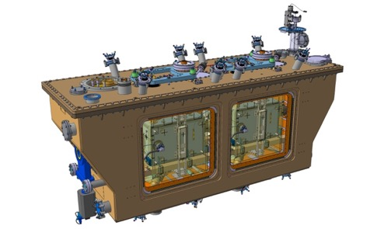
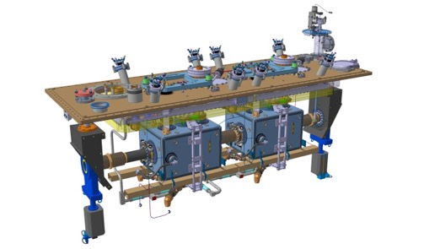
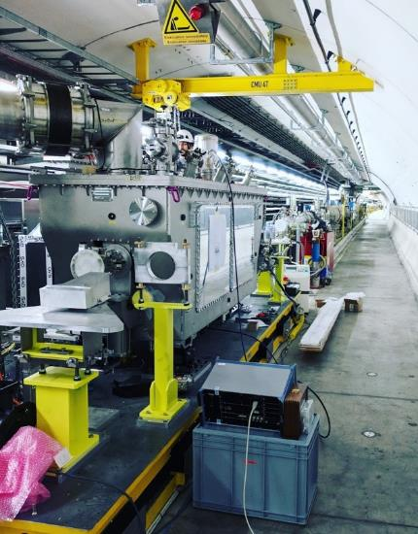
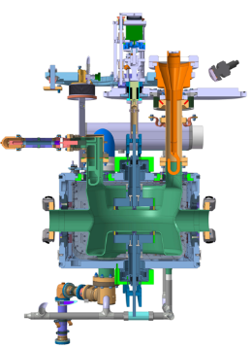
SPS Crab Test Stand
Field probe
Tuner
HOM Couplers (x3)
FPC
DQW crab cavity (vertical)
Helium Vessel
Cold magnetic shielding
SPS Test Stand

Slide 3
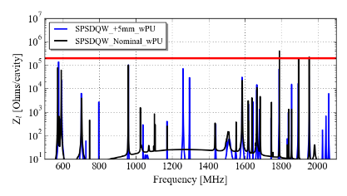
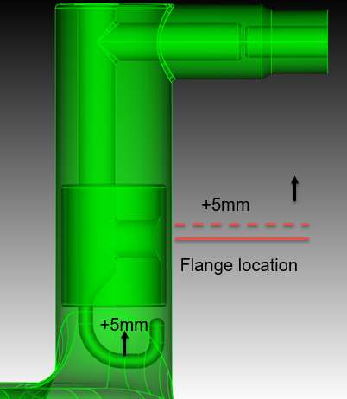
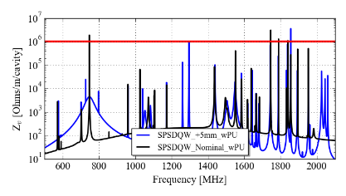
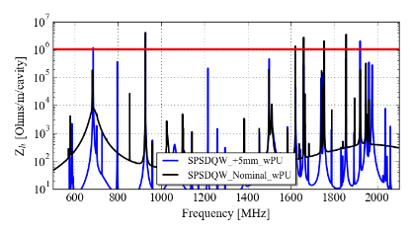
Non-conformity
All HOM coupler ports are + 5 mm compared to design.
Reduces coupling to majority of HOMs
Does not present impedance issue for SPS test.
SPS Test Stand

Slide 4
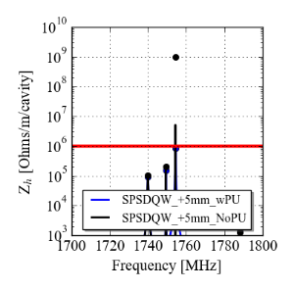
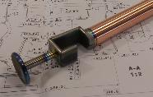
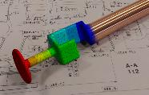
Field Probe as Fourth HOM coupler
The pick-up is designed extract 1 W at the fundamental mode frequency → Q_{e} = 1.6 x 10¹⁰.
It is also a HOM coupler for the 1.5 GHz and 1.75 GHz modes
→ cannot couple to this mode with HOM couplers.
The PU is made from Nb and Cu to avoid heating.
HOM Ancillaries

Slide 5
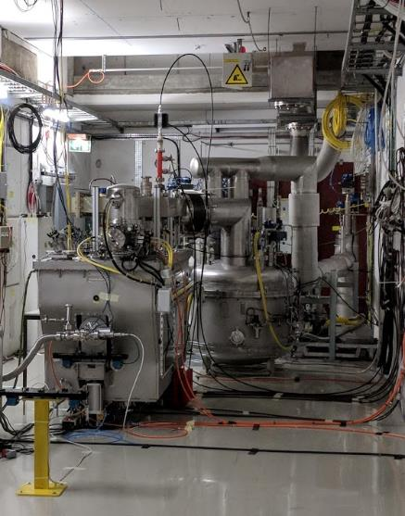
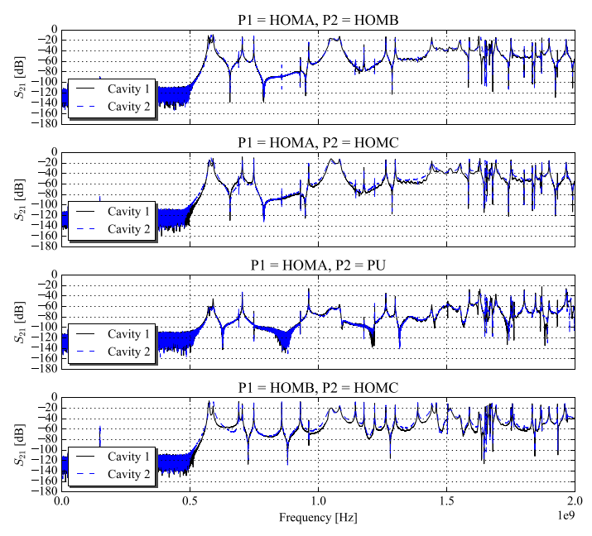
Mode Measurements
Transmission measurements using VNA in cryomodule cold test in M7 buncker.
Pre-Installation

Slide 6
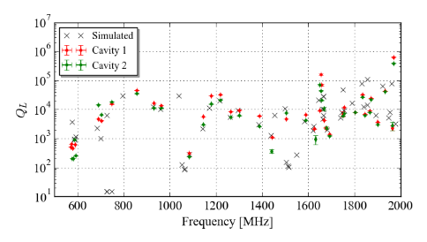
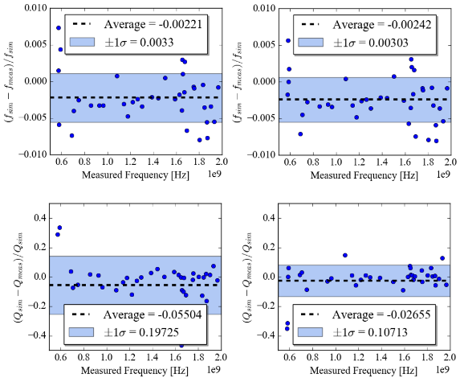
Mode Measurements
Transmission measurements using VNA in cryomodule cold test in M7 buncker.
Deviations are hence:
$$\frac{Δf}{f}=0.003$$
$$\frac{ΔQe}{Qe}=0.2$$
Pre-Installation

Slide 7
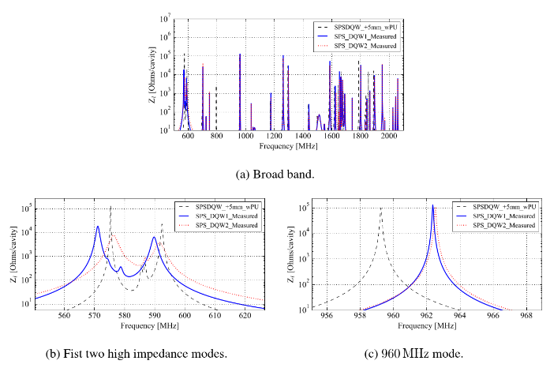
Modified Impedance Spectra
Impedance spectra:
Frequencies and Q_{e} values are known for a large number of modes.
Simulated spectra altered for both cavities.
Note, remembering to use the +5 mm simulation results!
For both cavities the 960 MHz mode has increased in frequency.
From BELOW to ABOVE the harmonic!
This shows it is feasible for the mode to be excited by the 24th harmonic at 25 ns bunch spacing.
Beam

Slide 8
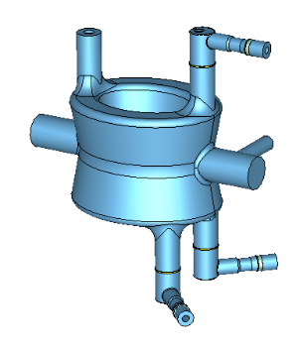
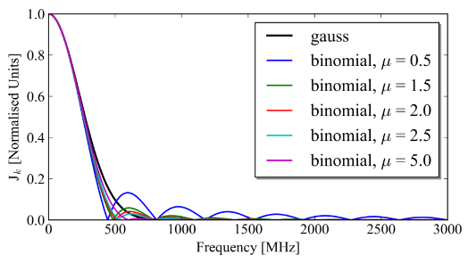
Measurements with Beam
Measurement aims:
Validate we can predict HOM power accurately.
Validate we have not ‘missed modes’ in simulation.
Validate power increases with intensity (and bunch number) as expected.
Analytic calculations:
A binomial distribution was used to represent the bunch profile.
H1
H2
H3
Beam

Slide 9
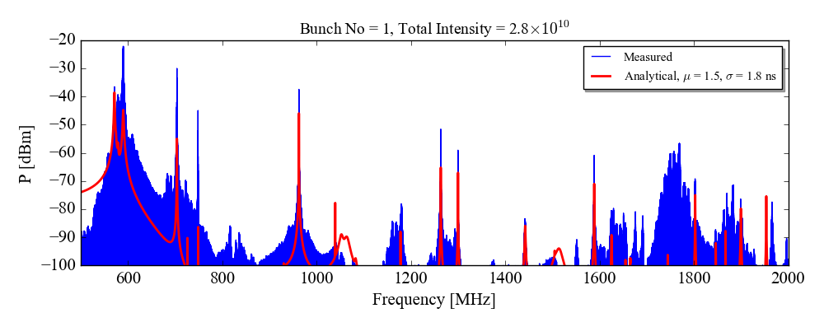
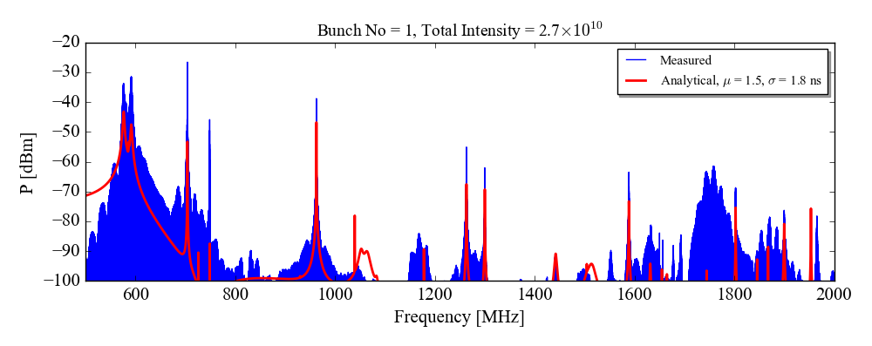
Meas. with Beam: Single Bunch
27/08/2018: MD4
Cavity 1 - HOMC1
Predicted is total power, not accounting for intra-coupler power flux.
Cavity 2 - HOMC1
Analytic underestimates
Unforeseen power at 1.8 GHz
Beam

Slide 10
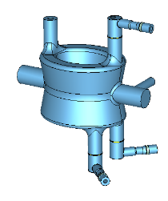
Meas. with Beam: Single Bunch
27/08/2018: MD4
Mode [MHz]
Top HOM Coupler
Bottom HOM Coupler
580
704
960
1263
High resolution narrow band scans also taken on high Z_{l} modes.
Analytic under-represents power in all cases.
Large coupling difference seen between modes.
Beam

Slide 11
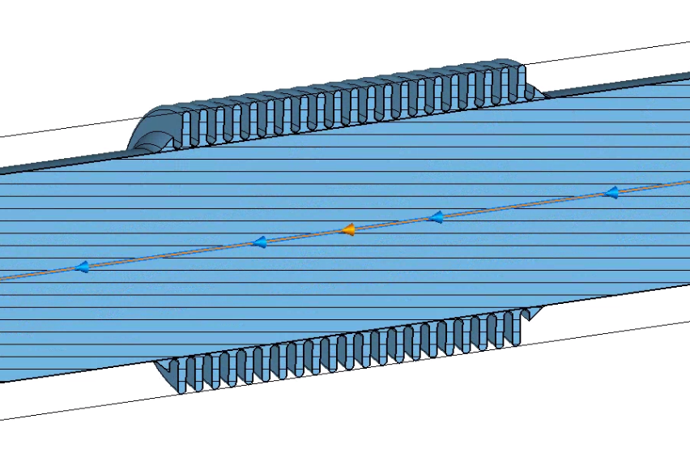
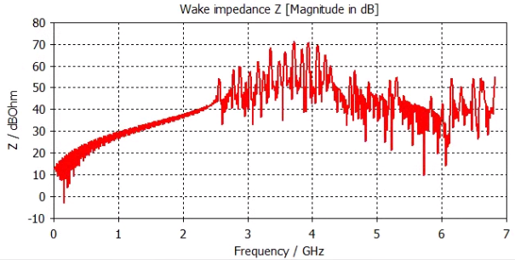
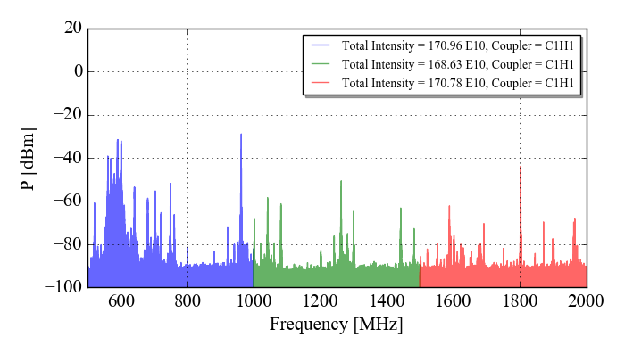
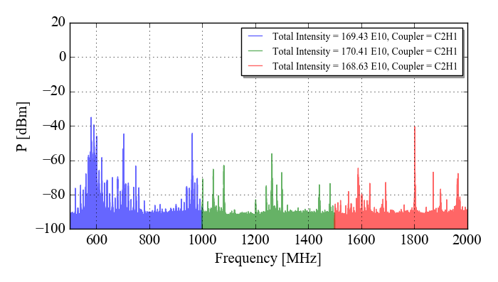
Meas. with Beam: 1.75 GHz
Contribution of a bellow?
10/10/2018: MD6: Removed band pass filter on pick-up
Not bellow impedance.
Mismatch on pick-up (HOM damper).
This will not be an issue in the future (see my talk on Thursday!)
Beam

Slide 12
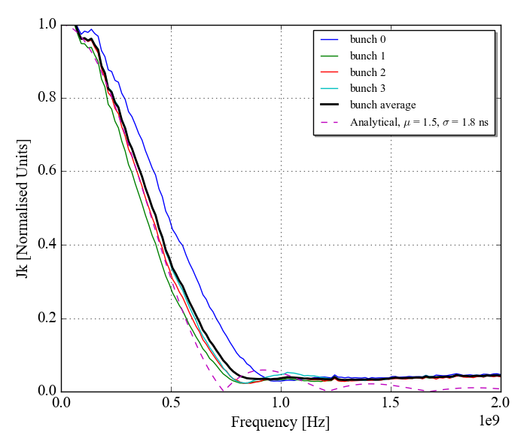
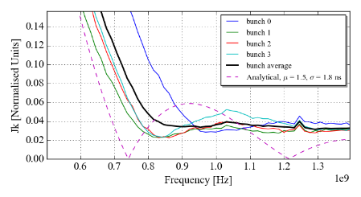
Meas. with Beam: Measured Profile
05/09/2018: MD5
To evaluate whether the beam profile was the cause of the underestimation.
In the following crab cavity test (MD5) the bunch profile was measured during the coasts.
This time multiple bunches were used with a bunch spacing of ~ 525 ns.
Courtesy of M. Schwarz
Conclusion: If HOM is near to binomial ‘node’: Optimistic and very sensitive to bunch length.
Beam

Slide 13
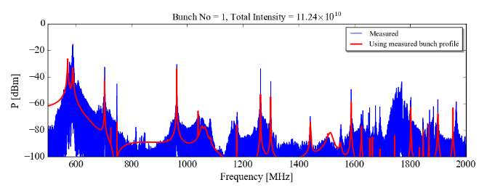
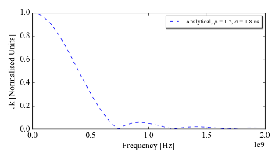
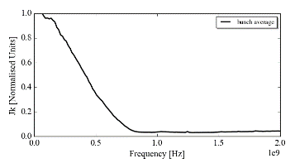
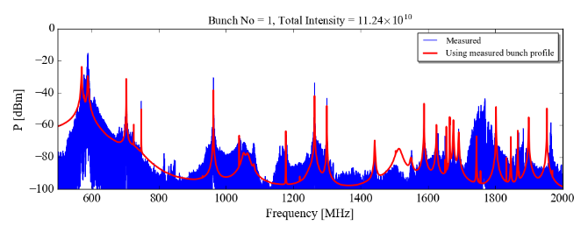
Meas. with Beam: Measured Bunch Profile
05/09/2018: MD5
Predicted is total power, not accounting for intra-coupler power flux.
There are still discrepancies between the measured and analytical.
This is under investigation:
Cable transfer function, mechanical position of HOM couplers, calibrations, bellows etc…
Beam

Slide 14
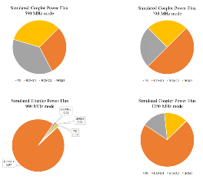
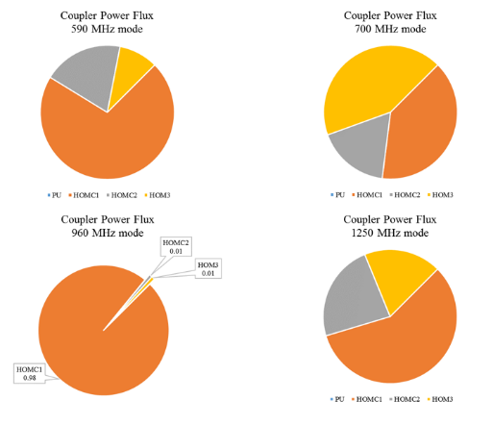
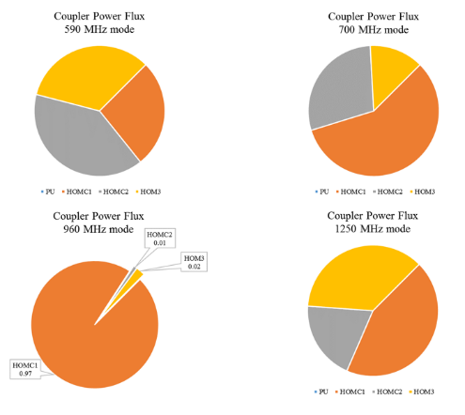
Meas. with Beam: Power Distribution
H1
H2
H3
Measured power ratio for 4 high longitudinal impedance modes.
Cavity 1
Cavity 2
Beam

Slide 15
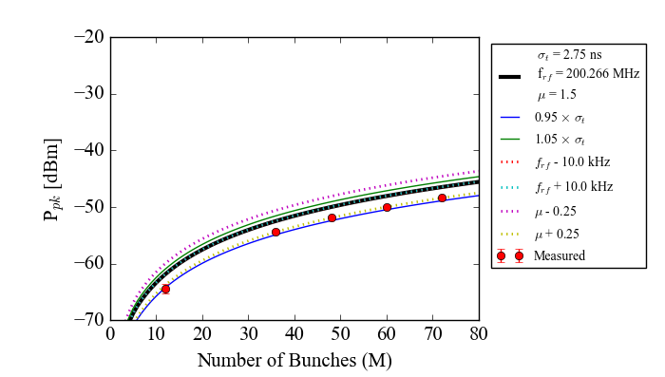
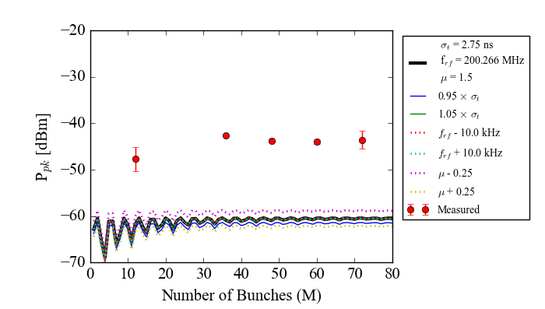
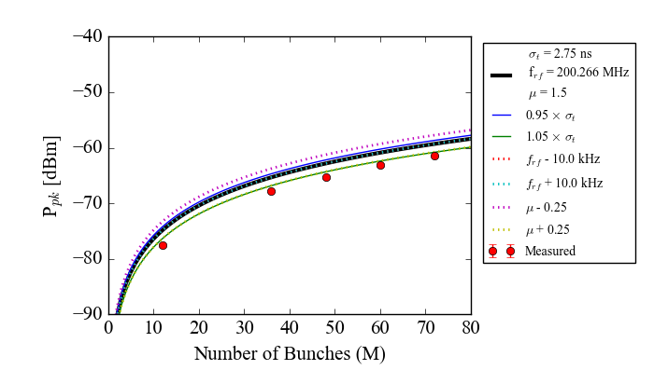
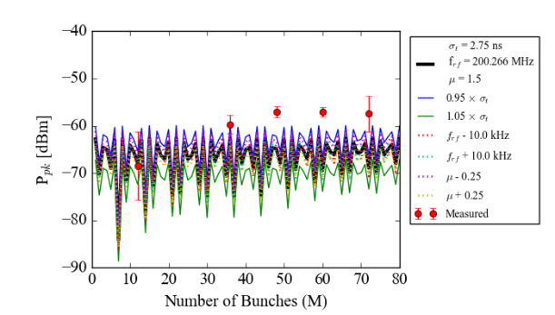
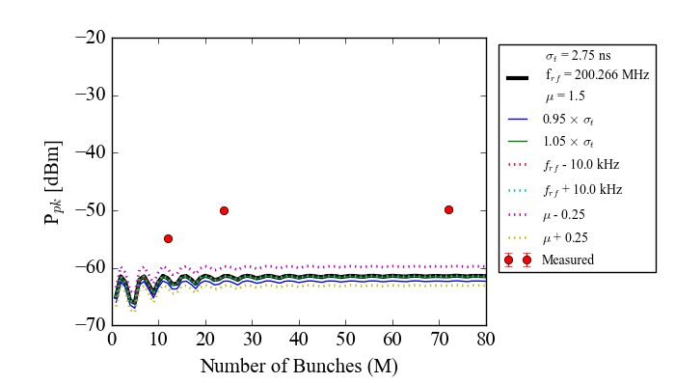
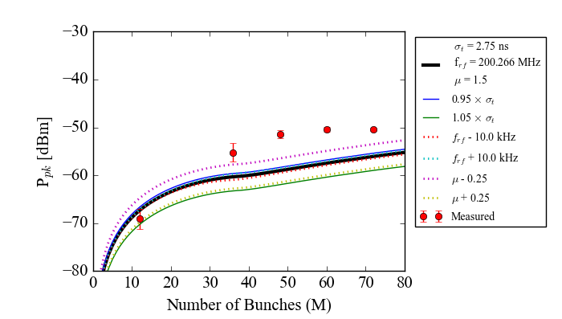
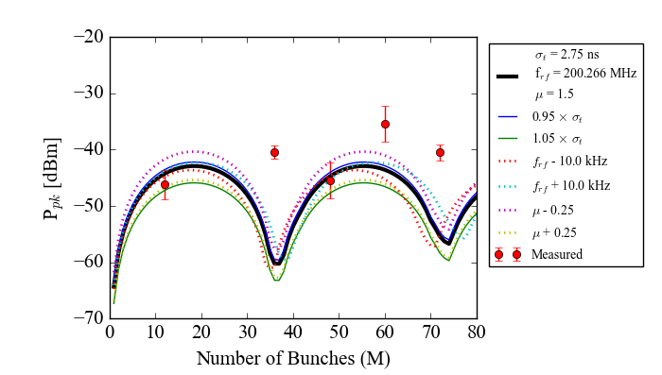
Meas. with Beam: Multibunch
27/08/2018: MD3
Cavity 1
Beam harmonics
Modes
Predicted is total power, not accounting for intra-coupler power flux.
560 MHz
590 MHz
590 MHz mode is underestimated by ~ 15 dB.
Using measured profile accounts for 5 dB.
Q or R/Q is underestimated.
For Cavity 2 the deviation is ~ 10 dB.
640 MHz
700 MHz
960 MHz
960 MHz
Beam

Slide 16
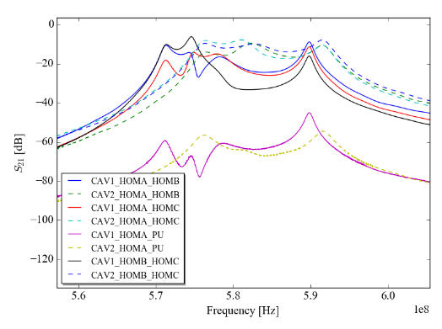
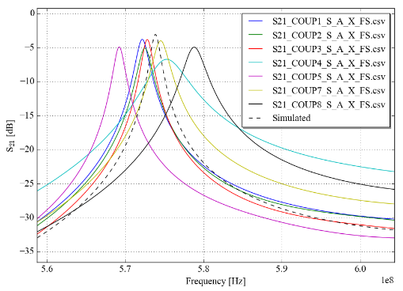
First HOMs
Underestimation in Q or R/Q
Q measurement could be perturbed by ‘valley-of-modes’.
Should use ‘poll-fitting’/multi-resonance fitting.
R/Q could change with alternative tuning.
Inter-cavity differences
Test-box measurements of each coupler show the spread in damping.
In the future specific couplers should be chosen for each port!
For example, the highest transmission at 960 MHz. should be used as the ‘top-coupler’.
Beam
Notes:
X-scale
Differences in coupling – under investigation

Slide 17
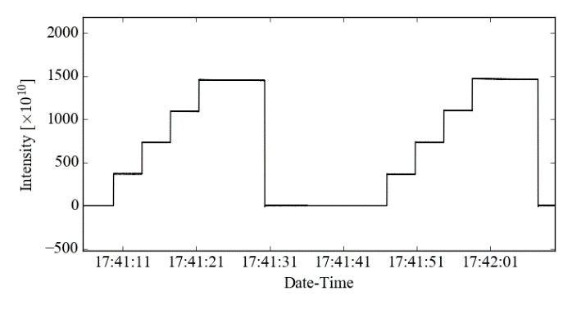
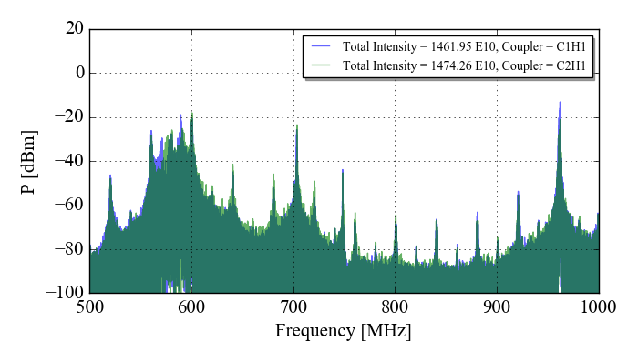
Meas. with Beam: High Intensity
~6 s
4 batches of 36 at Np = 1e11
Power measured at spectrum analyser.
Low resolution measurement due to filling time of 4 batches.
960 MHz mode highest power.
Around 100 mW peak at cavity (not resolved).
Beam

Slide 18
Conclusions
Pre-installation measurements of HOMs
Deviation from simulations.
Allow new impedance spectra to be generated.
High resolution broadband and single-mode with low number of bunches
Unforeseen power at 1.75 GHz – mismatch on pick-up (feed-back antenna).
Analytic under-represents – measured profile brings us closer – more analysis of this to come.
Mode dependant coupling ratio – all power at 960 MHz (most detrimental mode) through top coupler (see my Thursday talk).
Mode power as a function of bunch number
Big deviation for 590 MHz mode – investigations into Q, R/Q and I(ω).
High Intensity
Ongoing analysis.
On-going work: longitudinal and transverse R/Q measurement.
…Thanks again to Rama, Lee and Graeme.
Notes:
X-scale
Differences in coupling – under investigation

