Slide 1
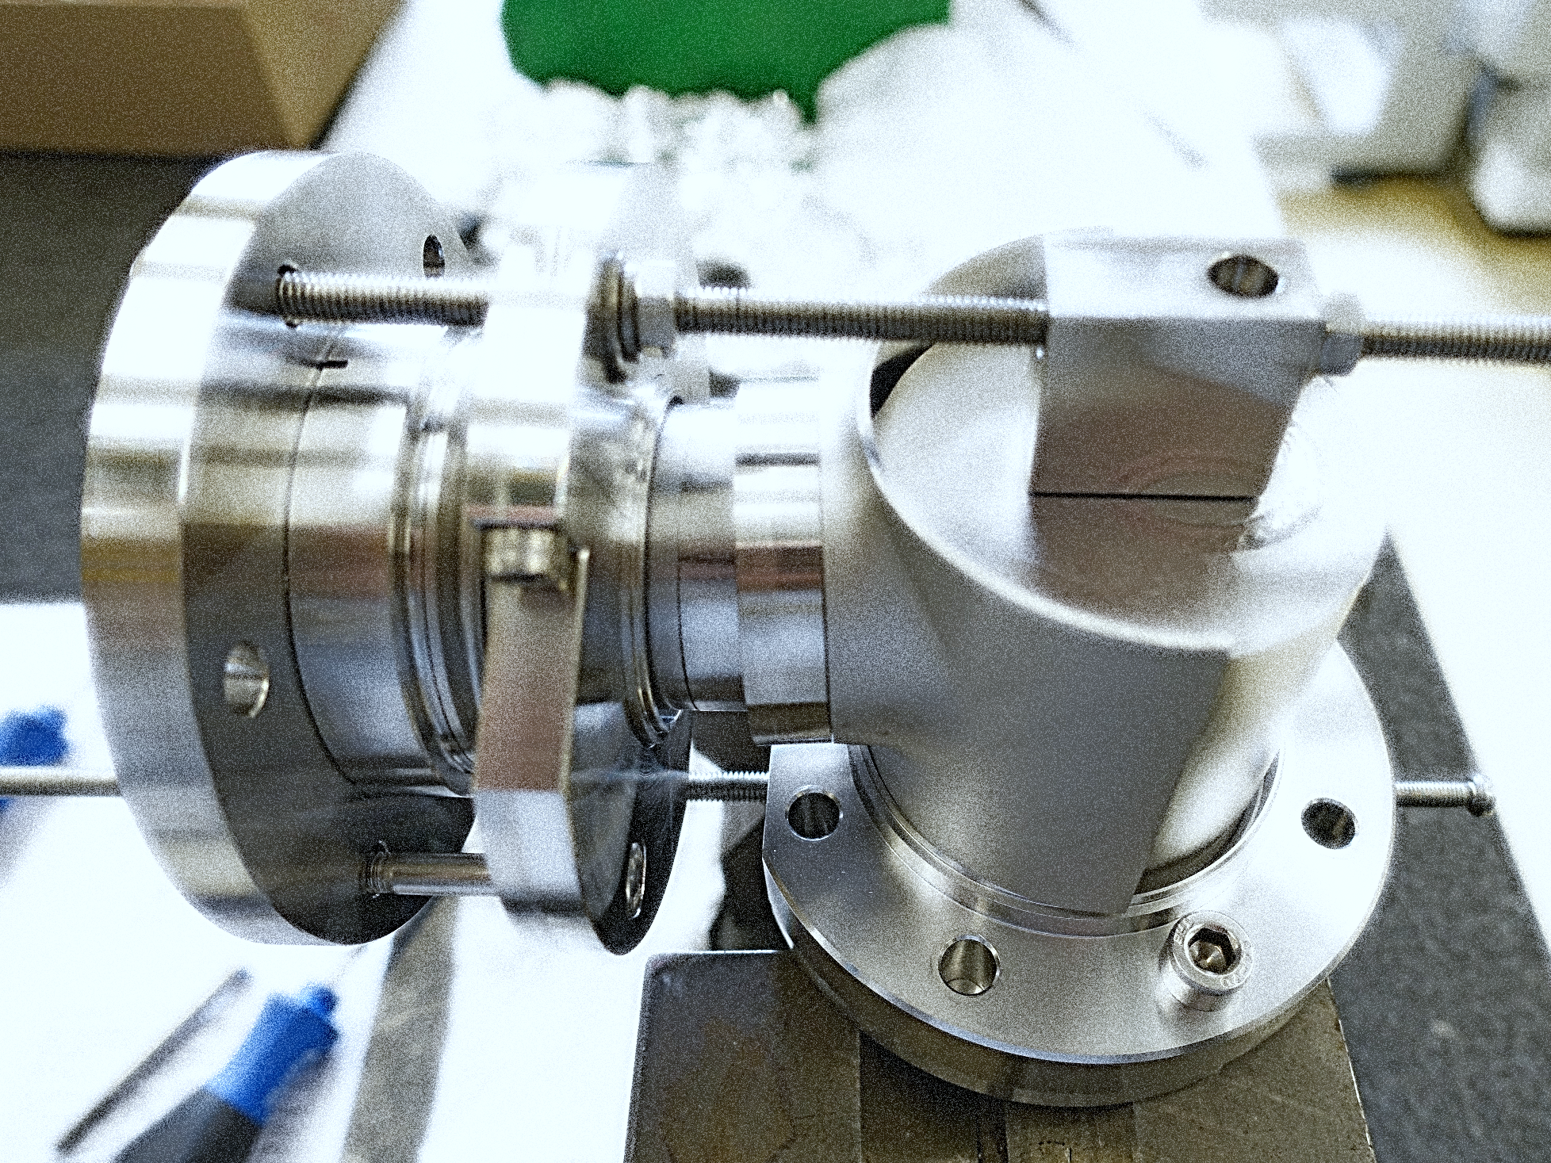
DQW HOM Update and Recent Developments
J. A. Mitchell ^{1, 2}
¹Engineering Department, Lancaster University: Graeme Burt
²BE-RF Section, CERN: Rama Calaga
8th HL-LHC Collaboration Meeting
CERN, Geneva, Switzerland, 18th October 2018

Slide 2
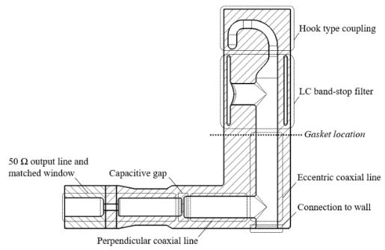
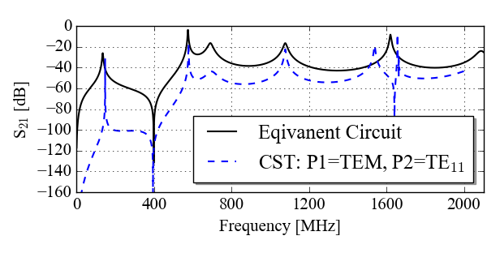
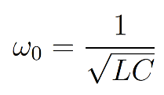
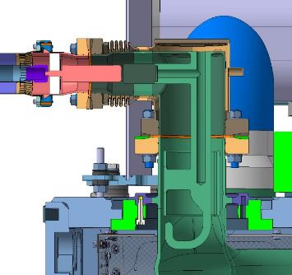
DQW HOM Coupler
Vacuum model
Operation:
Hook-type coupling (electric and magnetic).
Demountable.
High-pass filter response.
LC band-stop filter.
Capacitively coupled output.
Broadens notch.
No moment on window.
Niobium
Conductively cooled by superfluid L-He (2 K)

Slide 3
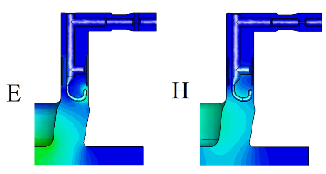
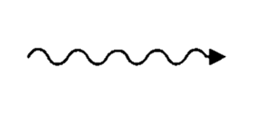
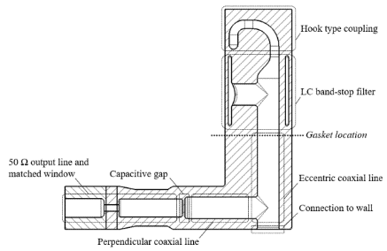
DQW HOMC: Design Advantages
Gasket location
Gasket heating
The LC band-stop is before the gasket.
This acts like an electrical short.
Very little dynamic heat load on the copper gasket (~ mW)!
CRYOMODULE HAS DYNAMIC HEAT LOAD LIMIT (~ 20 W).
Beam
2. Window location
Window is perpendicular to charged particles ejected from beam.
Screening current on window avoided
WINDOW BREAKS → CRYOMODULE DOWN!

Slide 4
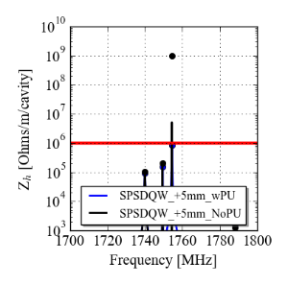
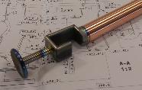
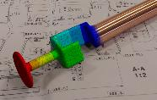
Field Probe as Fourth HOM coupler
The pick-up is designed extract 1 W at the fundamental mode frequency → Q_{e} = 1.6 x 10¹⁰.
It is also a HOM coupler for the 1.75 GHz mode → cannot couple to this mode with HOM couplers.
The PU is made from Nb and Cu to avoid heating.

Slide 5
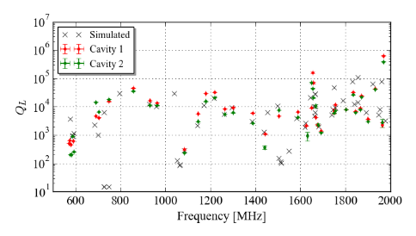
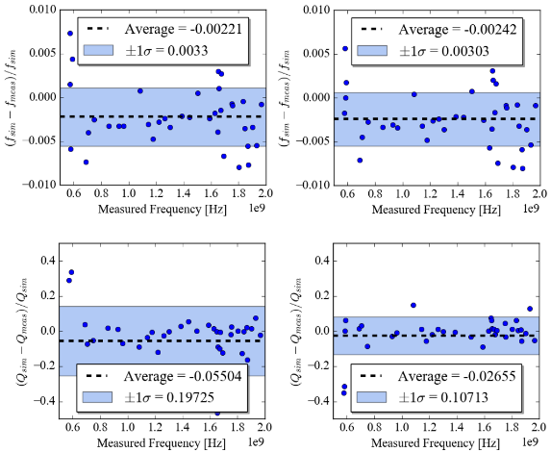
Mode Measurements
Transmission measurements using VNA in cryomodule cold test in M7 buncker.
Deviations are hence:
$$\frac{Δf}{f}=0.003$$
$$\frac{ΔQe}{Qe}=0.2$$

Slide 6
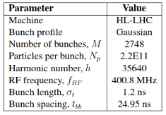
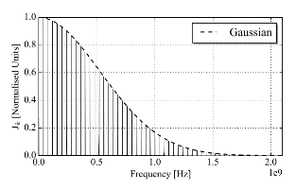
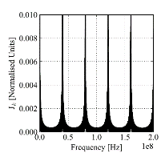
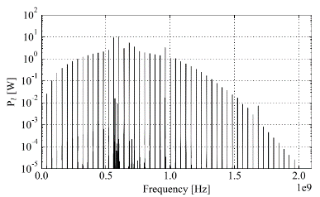
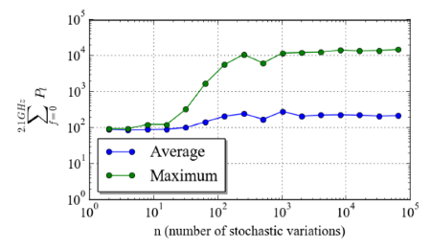
HOM Power
Using SPS HOM coupler and HL-LHC parameters:
$$ΣP<100 W$$
However, the frequency and Q_{e} of the modes can change.
Stochastically varying these two parameters, a worst-case power can be calculated.
13 times larger than 1 kW limit.
Due to mode at 960 MHz – coupler needs to be altered.

Slide 7
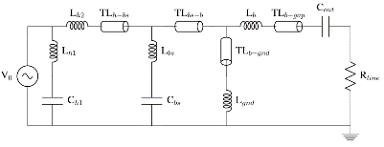
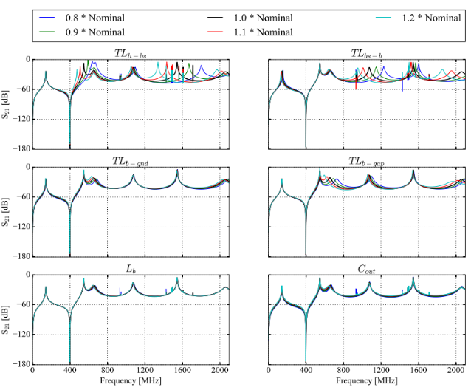
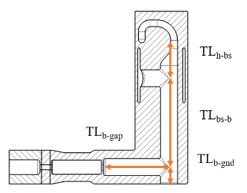
SPS HOM Coupler Development
The coupler should be altered to:
Reduce transverse impedance below threshold.
Reduce maximum foreseeable HOM power to below 1 kW.
Improve ease of manufacture.

Slide 8
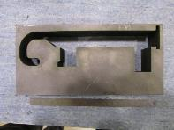
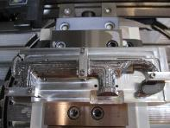
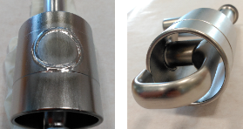
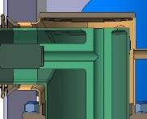
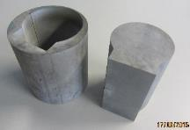
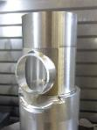
SPS HOM Coupler Development
The coupler should be altered to:
Reduce transverse impedance below threshold.
Reduce maximum foreseeable HOM power to below 1 kW.
Improve ease of manufacture.
Issue
Solution
Machining time for circular cross-section.
Rectangular cross-section.
Difficult to EB-Weld on curved surface.
Flat section on capacitive jacket.
Wasted Material:
Perpendicular coax line is ‘flush’ with coupler base.
Lift output line.

Slide 9
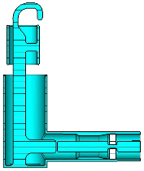
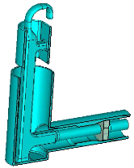
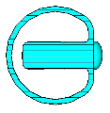
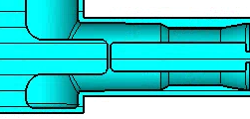
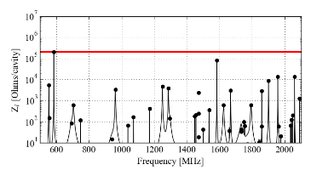
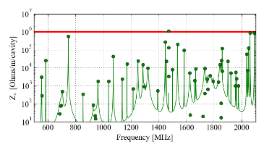
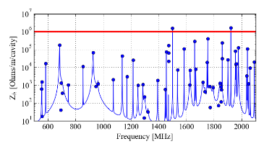
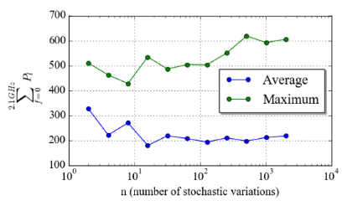
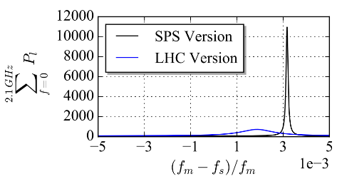
DQW HOMC V2
Flat section on capacitive jacket.
Square profile throughout.
Lifted output line for extruded ‘can’.
Highest power still a result of the 960 MHz mode.
If we vary this mode in frequency:

Slide 10
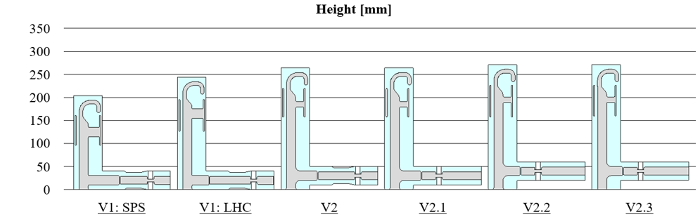
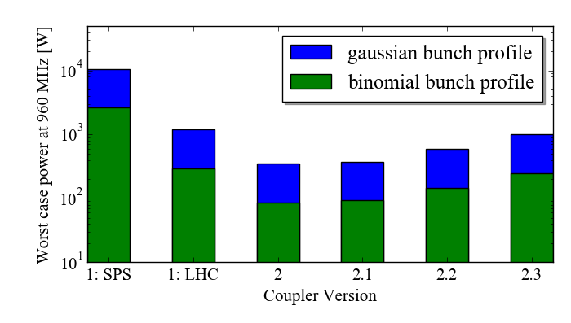
Evolution: Where we are today
Presented at HiLumi’17
Assembly constraints…
Following the coupler presented at HiLumi’17 some alterations for easier assembly.
However V2.2 and 2.3 started to increase the power of the 960 MHz mode.
As the SPS tests showed up that all of this power goes through one HOM coupler, VERSION 2.1 was selected.

Slide 11
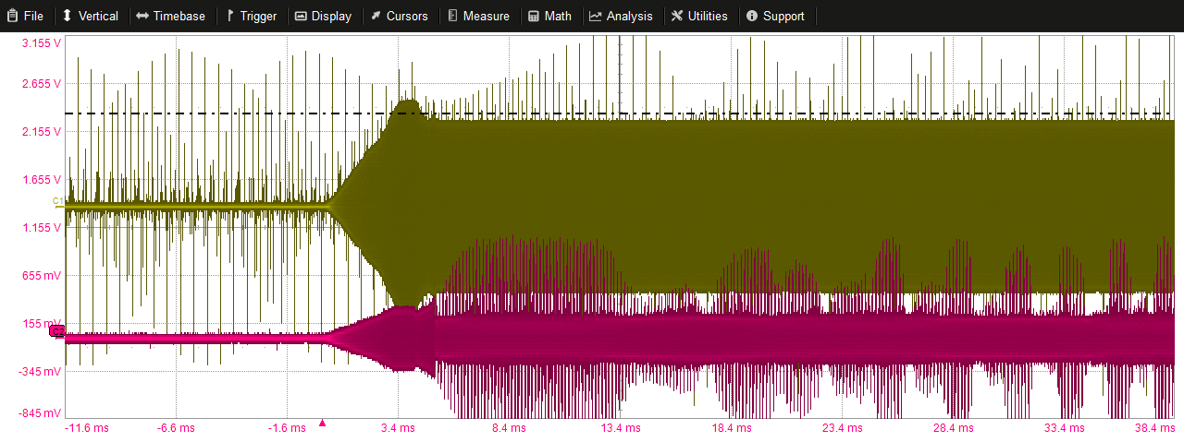
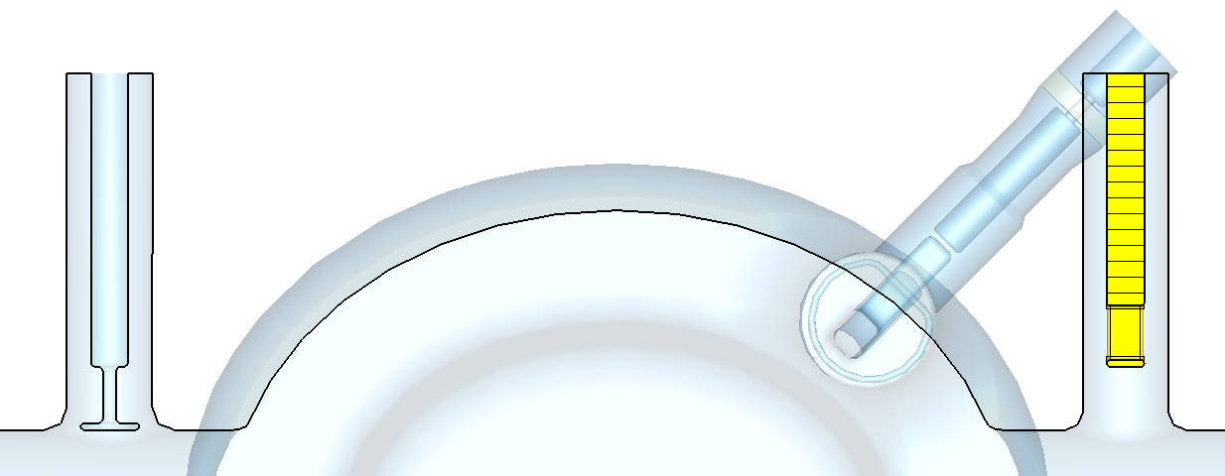
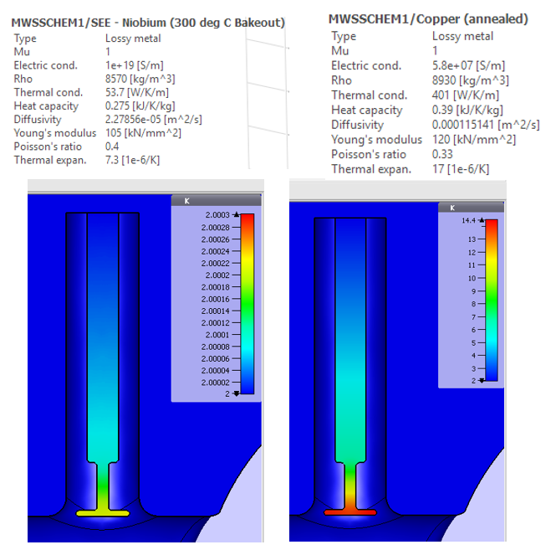
New beam pipe damper
Antenna is also HOM coupler.
SPS tests showed that ‘mushroom’ was coupling to the beam and creating difficulties for LLRF feedback.
P. Baudrenghien
Hence separated into HOM damper and antenna.
New Port
Mushroom removed
Currently deciding between copper and niobium.
Preliminary simulations show copper is okay.
Feedthrough and boundary conditions under current analysis!
1.5 and 1.75 GHz HOM damper
… could also be used as second antenna if primary fails, although ~10 x lower coupling.
… antenna will also be modified – see S. Verdu-Andres’ Talk (Thursday: DQW and RFD PUs)

Slide 12
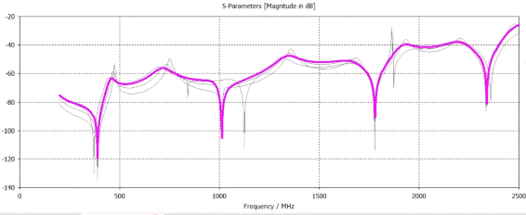
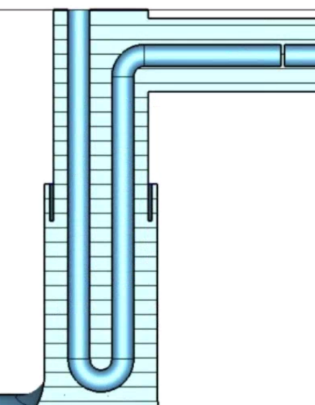
DQW HOMC: Alternative
Operation
Quarter wave rejection filter – centered at fundamental mode.
Harmonics reject also.
Advantages
Loop type coupling – magnetic coupling to HOMs – good broad-band damping.
High H-Field on cooled section – no $Δ$T to He.
Very easy to manufacture - mass produce.
Disadvantages
Gasket heat-load – 1000 x higher than LC stopband (~0.5)
Harmonics can be moved slightly but will always be present.
$$Gasket H−shield$$
$$\frac{λ}{4}=(c/f)/4=(3E8/400E6)/4=188 mm$$
Design still work in progress
Could be a valid alternative if gasket dynamic heat-load is further reduced or if indium gaskets are used.

Slide 13
Conclusions
Pre-installation measurements of HOMs
Deviation from simulations.
Shows worst case power is too high due to 960 MHz mode.
Coupler re-designed with RF and manufacture criterion
Longitudinal and transverse impedances within threshold.
Maximum power foreseeable < 1kW.
Easier to manufacture.
New Beam Pipe HOM damper
To separate the HOM damping and antenna functions of the current antenna.
Design reached, multi-physics analysis on going.
Alternative HOM coupler under development
Quarter wave rejection filter being designed.
Simple to manufacture and less risk of thermal quench.
Higher heat-load on gasket.
Notes:
X-scale
Differences in coupling – under investigation

Slide 14
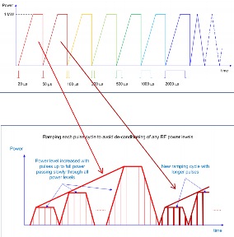
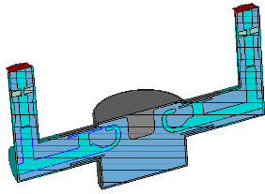
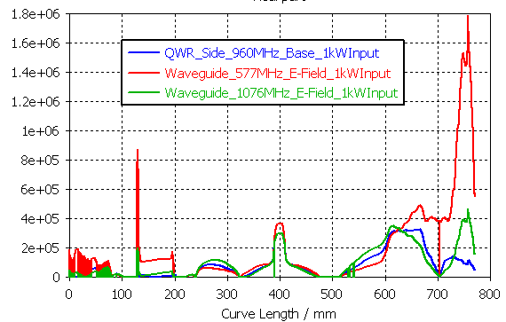
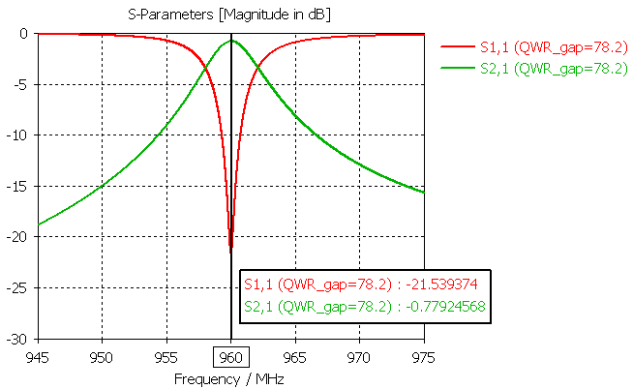
Future Ideas – HOMC Conditioning
FPC’s are conditioned before installation:
Acceptance test, desorption of absorbed gasses, ensuring required power level (without RF breakdown), training ceramic…
Technique
Power, pulse length, duty cycle: Low → High (with FM and AM)
Using ‘test-box’ in travelling wave mode.
HOM couplers are becoming higher and higher in power
Do not see high power at high frequency until beam!

