Slide 1
CERN RFD
HOM Measurements
On behalf of SY-RF-AC and HL-LHC WP4

Slide 2
Outline
RFD Crab cavity HOM couplers
Z₀ = 25 ohm
25 ohm impedance adapters.
Pre-installation test-box measurements.
HOM measurements of the jacketed cavities at 2 K.

Slide 3
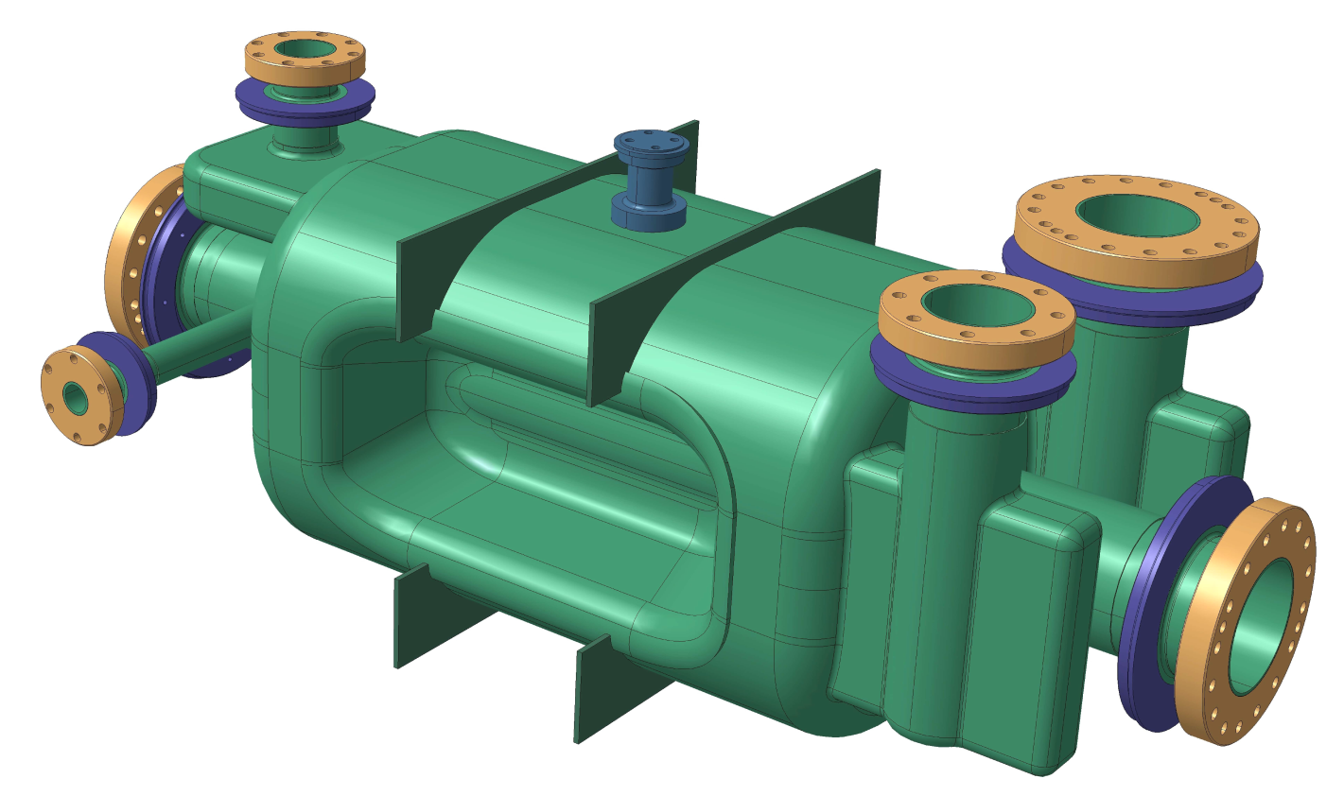
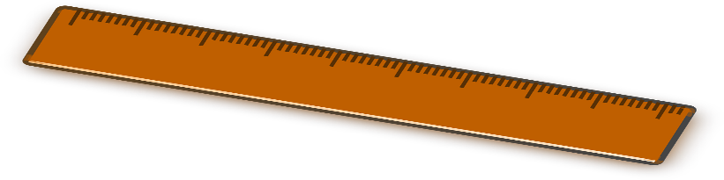
CERN RFD crab cavities
Crabbing in the horizontal plane.
2 cavities (inc. couplers) manufactured at CERN for tests in the SPS.
RFD #1
RFD #2
- 2 mm
2 mm shorter than nominal design to tune the fundamental mode frequency.

Slide 4
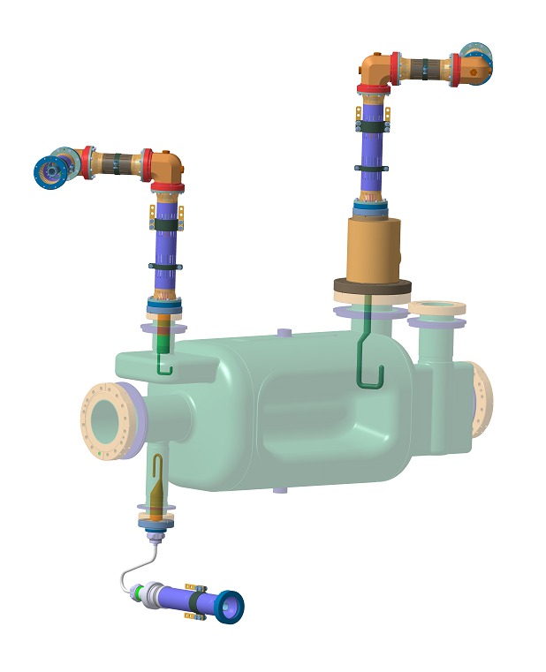
RFD HOM couplers
V-HOMC
Damps HOMs with high Z_{⊥v} and Z∥
100 W_{p} range
H-HOMC
Damps HOMs with high Z_{⊥h} and Z∥
kW_{p} range
Field Antenna (FA)
Couples 1 W of the 400 MHz signal.

Slide 5
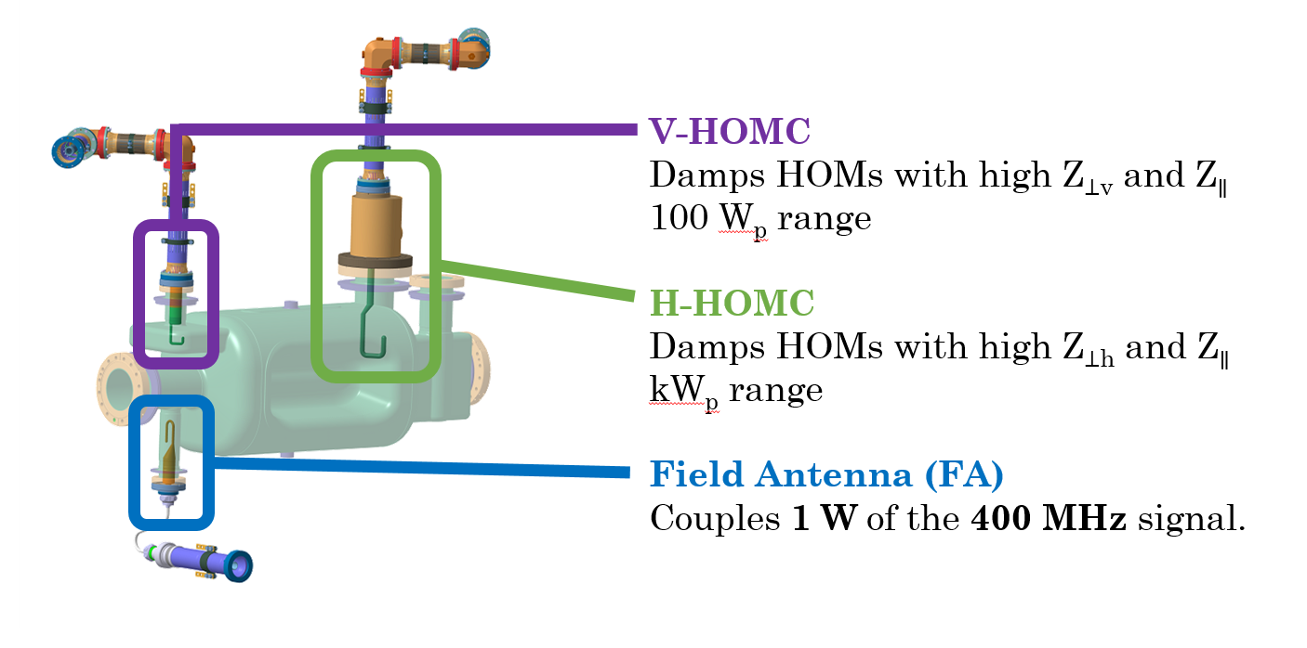
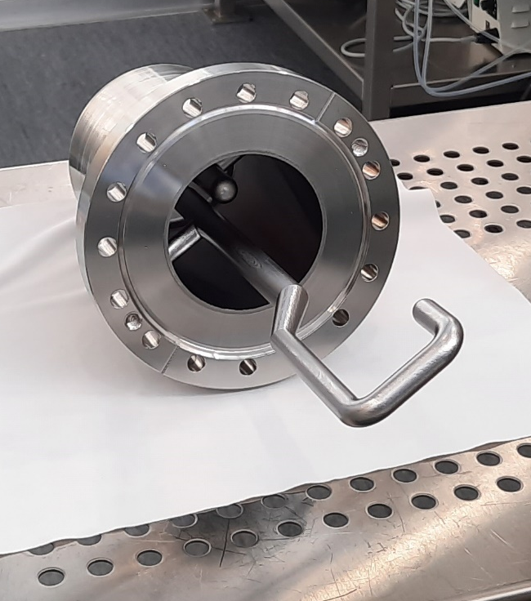
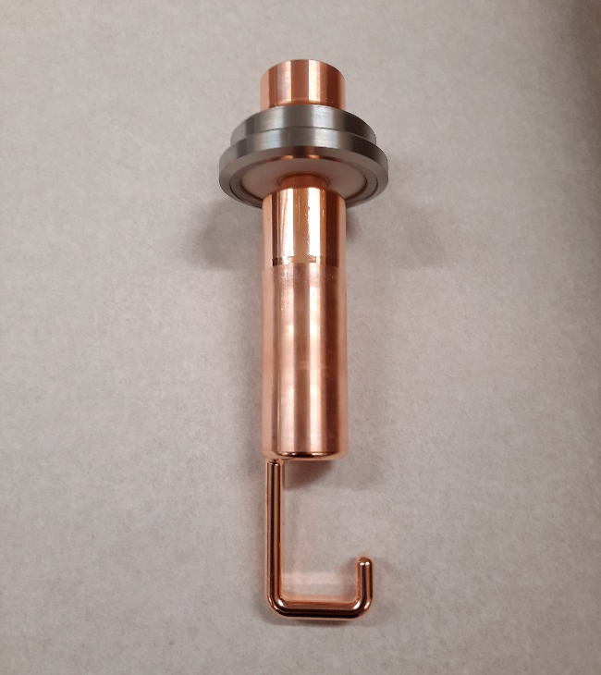
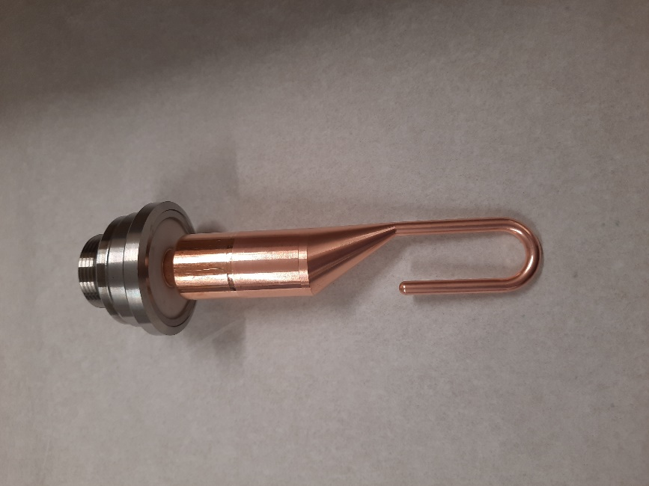
RFD HOM couplers
H-HOMC
V-HOMC
FA
… with huge thanks to our colleagues in EN-MME!

Slide 6
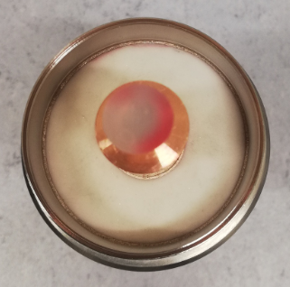
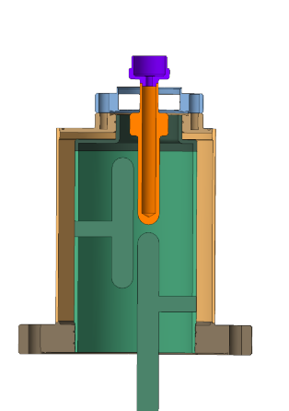
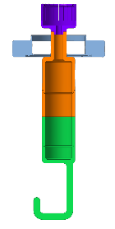
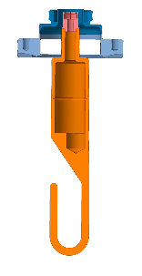
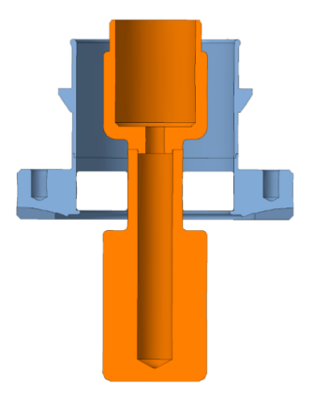
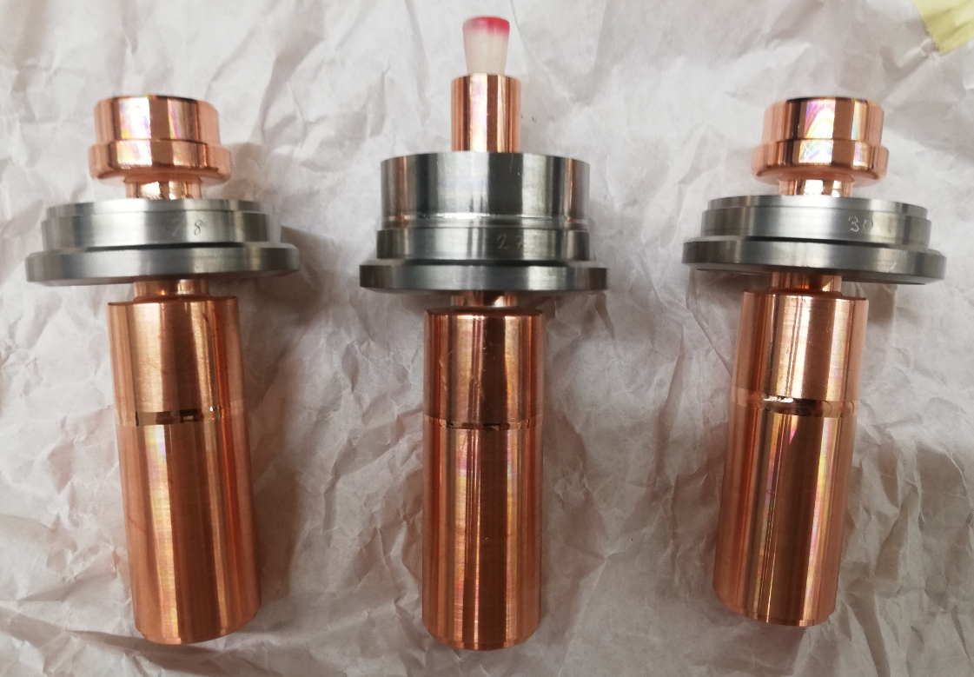

Feedthroughs
See talk by E. Montesinos for more details.
With Al₂O₃, the inner diameter increases by a factor of 3.7 if we move to 25 Ω!
25 Ω to increase the diameter of inner conductor… $\text{Z}\text{0} \text{∝} \frac{log\left(Do/Di\right)}{\sqrt{ε_{r}}}$
Verified in simulations to give good HOM damping.
Thermal and mechanical shock tests to arrive at a standard feedthrough design.

Slide 7

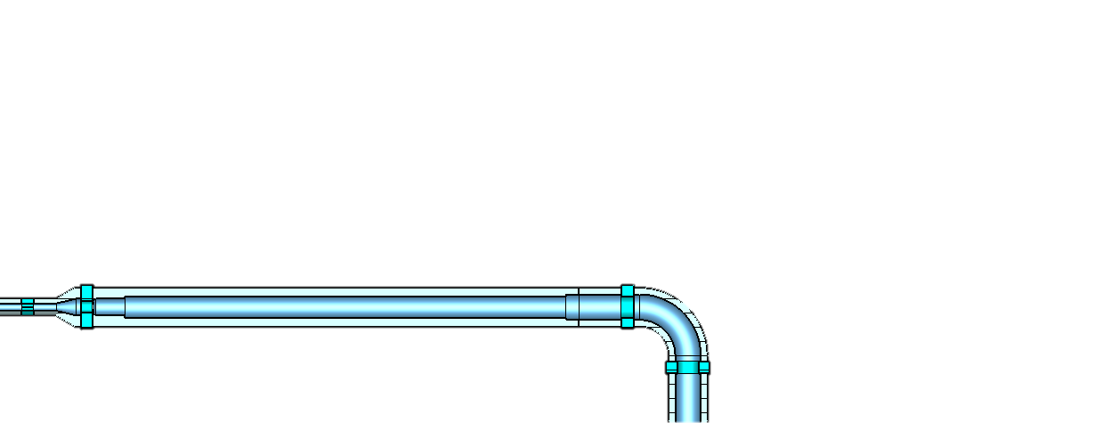
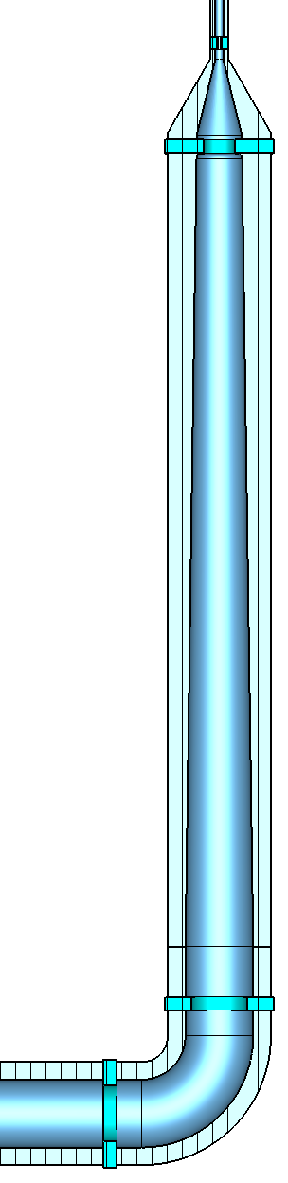
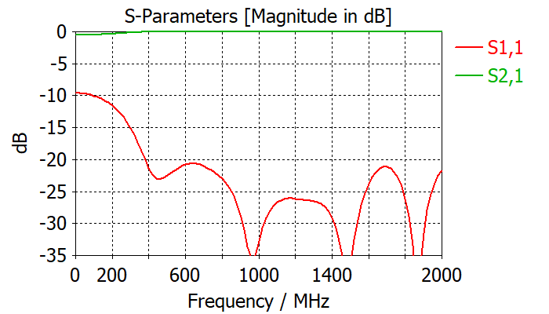
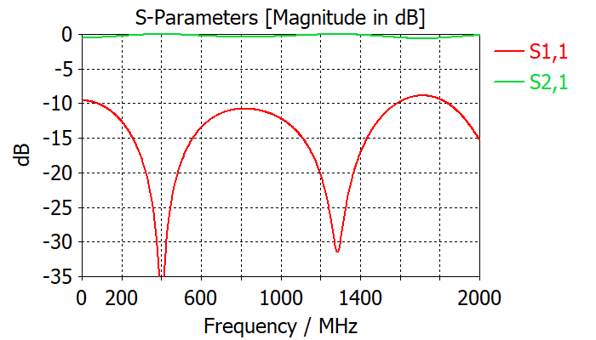
Impedance adapters
Developed with...
See talk by K. Turaj for more details.
25 to 50 Ω adapters designed to qualify the HOM couplers and antennas before and after installation onto the cavity.
50 Ω
50 Ω
OD = 40 mm (25 Ω) → N-type (50 Ω)
VHOMC and HHOMC (inc. test box).
Taper for broadband impedance transformation.
~ 450 mm
OD = 16 mm (25 Ω) → N-type (50 Ω)
Field antenna.
Quarter wave transformer (400 MHz)
~ 300 mm
Could also use taper for broadband, but longer.
25 Ω
25 Ω
400 MHz

Slide 8

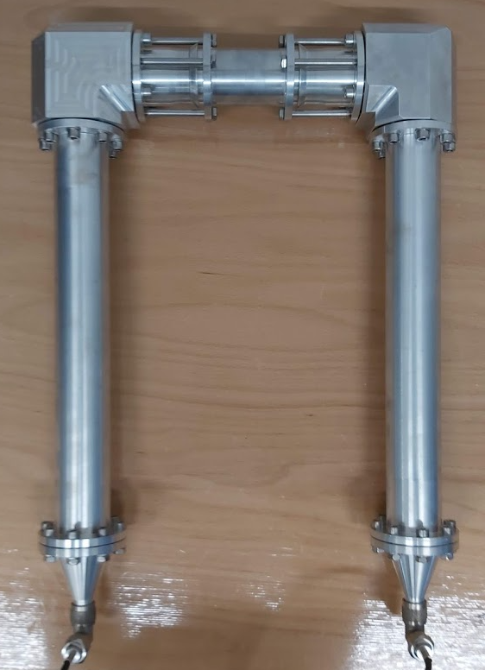
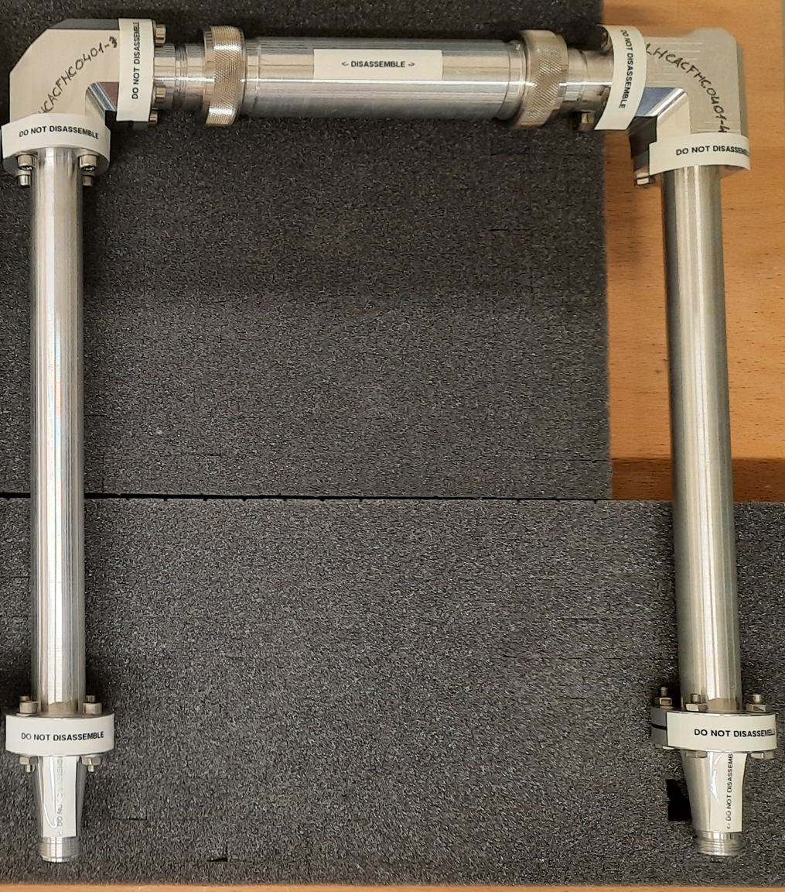
Impedance adapters
Developed with...
See talk by K. Turaj for more details.
25 to 50 Ω adapters designed to qualify the HOM couplers and antennas before and after installation onto the cavity.
‘Back-to-back’ measurements qualified the adapters functionality
Back-to-back measurements
Adapter V/H-HOMC:
S21 > -0.5 dB broad-band
Adapter FA:
S21 > -0.1 dB at 400 MHz

Slide 9
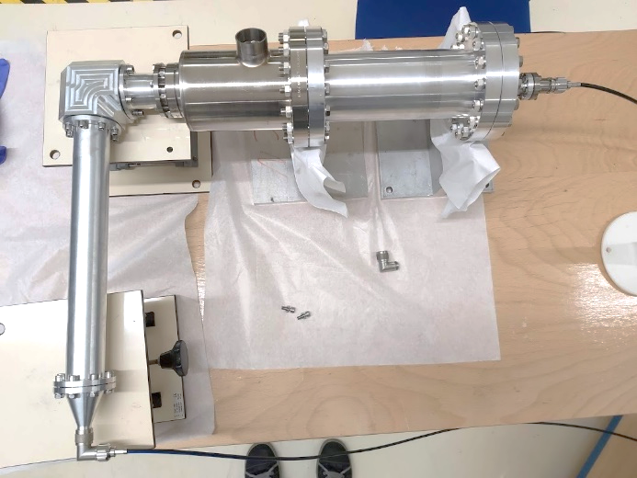
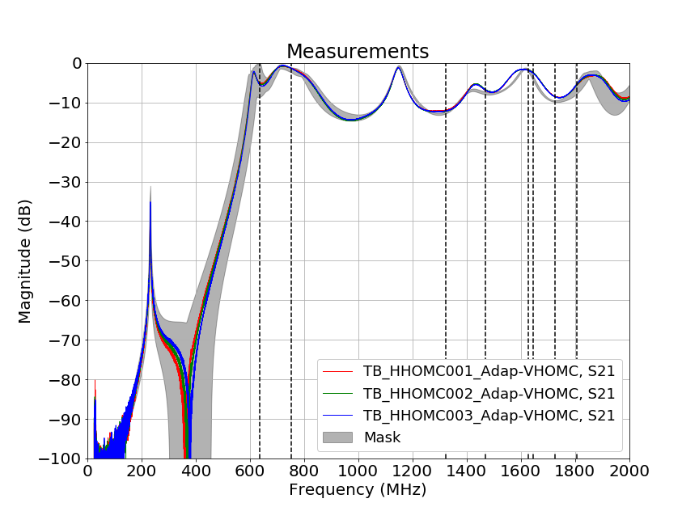
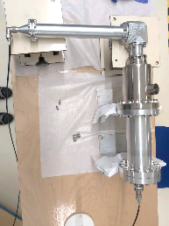
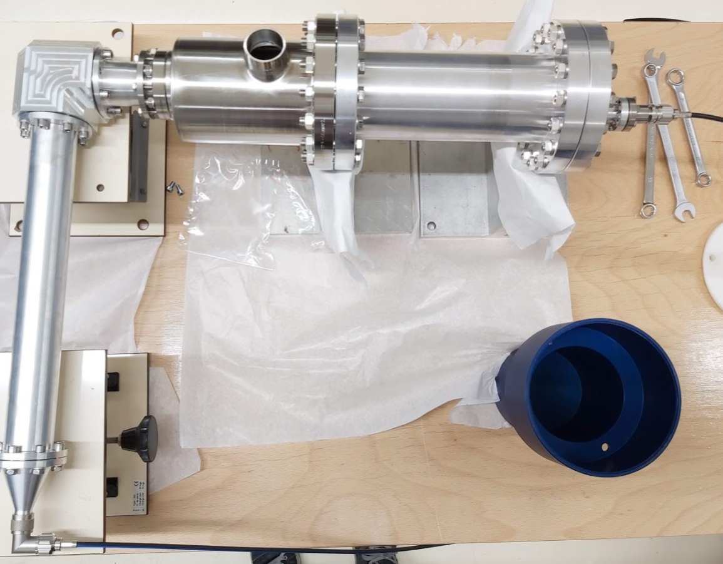
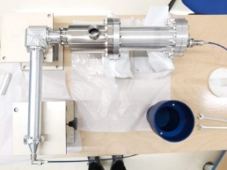
HHOMC Test-box
Developed with...
Text boxes designed to test and quantify the functionality of the couplers.
At frequencies < 1.2 GHz, the curves fit well within the mask: Qualified most important frequency range.
At high frequencies, the couplers are very close to the designed response.
Looking into measurement technique to validate at high frequencies.
The similarity of the three couplers shows very good manufacturing consistency.
HHOMC 001
HHOMC 002
HHOMC 003

Slide 10
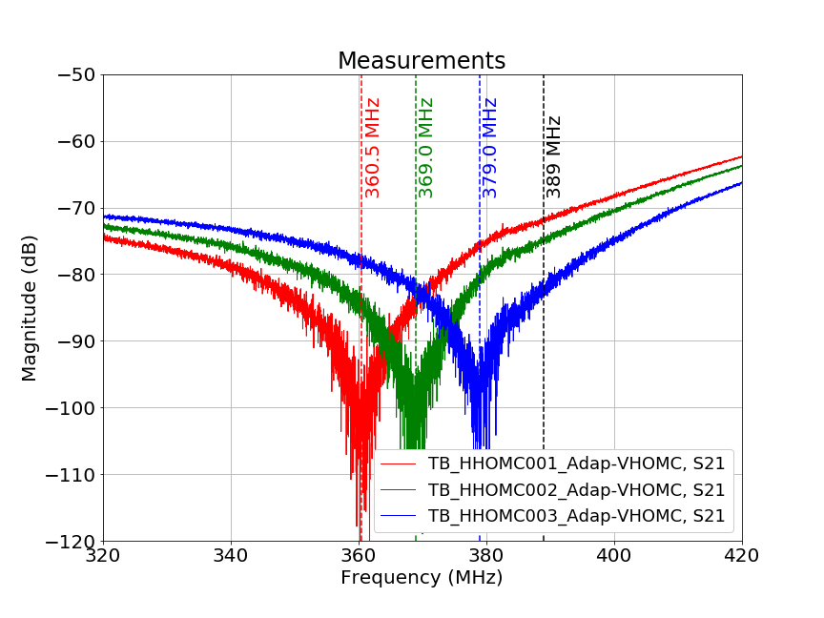
HHOMC Test-box
Developed with...
Text boxes designed to test and quantify the functionality of the couplers.
At frequencies < 1.2 GHz, the curves fit well within the mask: Qualified most important frequency range.
At high frequencies, the couplers are very close to the designed response.
Looking into measurement technique to validate at high frequencies.
The similarity of the three couplers shows very good manufacturing consistency.
HHOMC 001
Fundamental mode rejection sufficient for all three couplers.
Fantastic achievement from our colleagues in EN-MME!
HHOMC 002
HHOMC 003

Slide 11
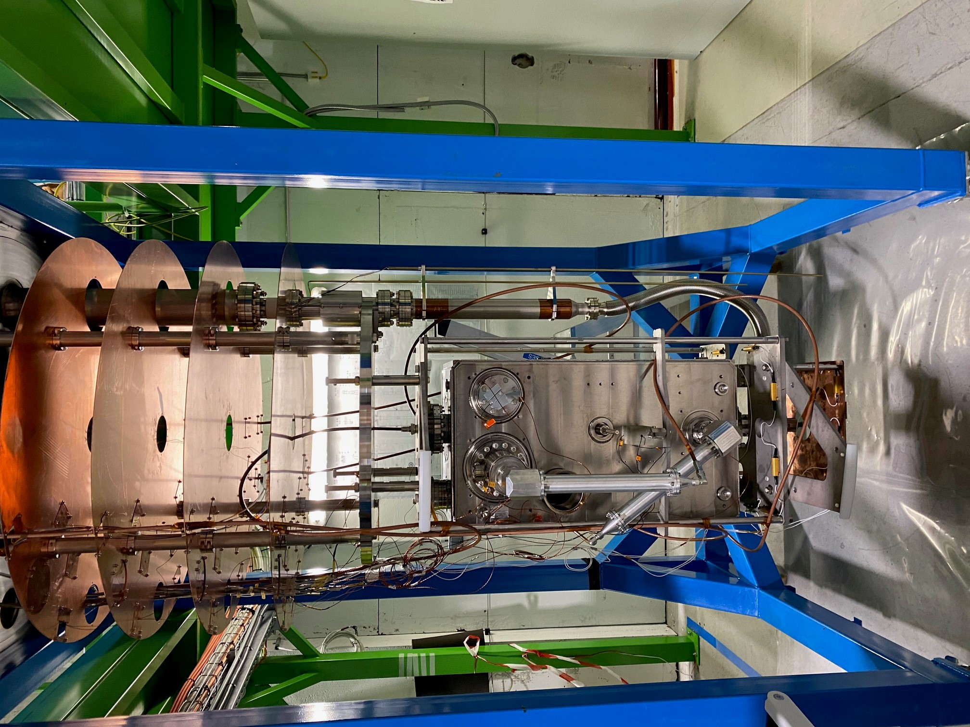
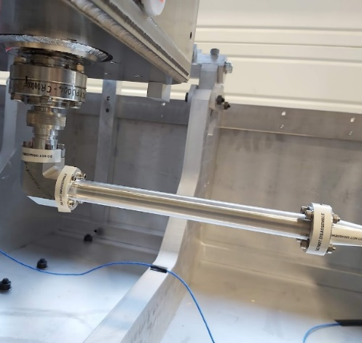
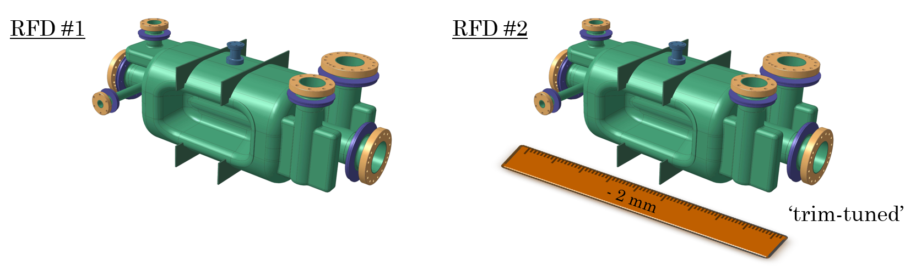
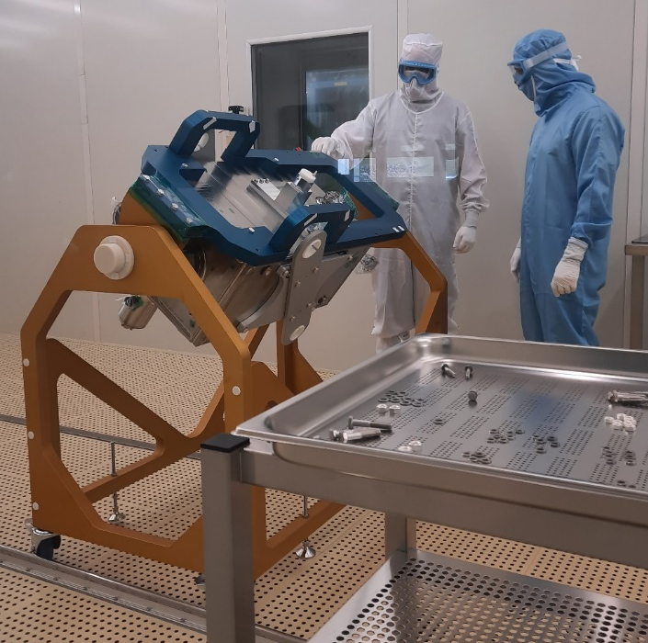
Vertical tests
See talk by K. Turaj for more details.
RFD2
Field antenna impedance adapter contact problem.
Non-conformity report. [1]
HOM measurements taken between the HHOMC and VHOMC. Qualified.
Adapter fixed, no second test necessary for cavity qualification.
RFD1
APRIL) Test 1: Leak (ancillaries changed to spare set afterwards)
NO HOM measurements
MAY) Test 2: Second vacuum leak (new ancillaries)
NO HOM measurements
AUG) Test 3: Successfully tested.
HOM measurements taken at 2 K. Qualified.

Slide 12
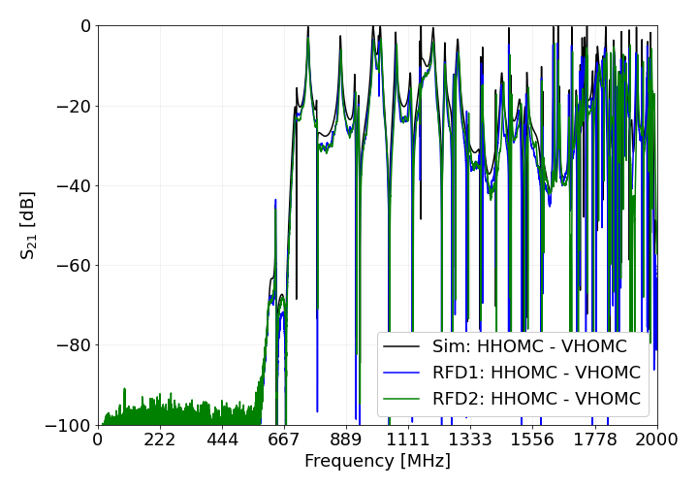
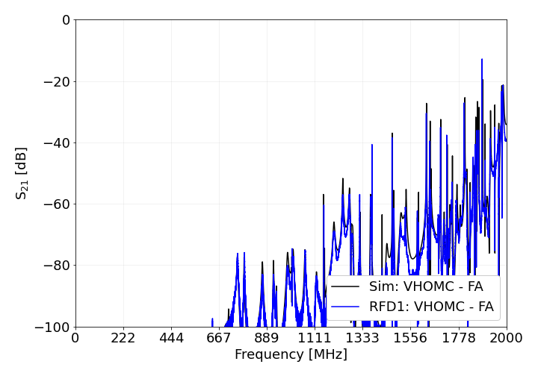
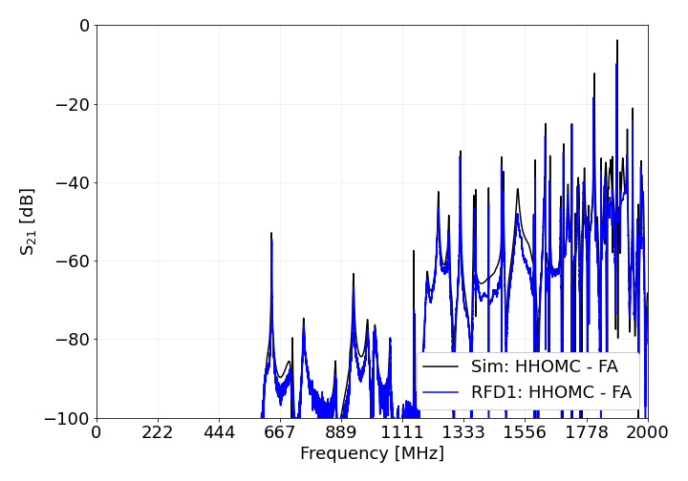
Transmission measurements
S₂₁ measurements taken between the ancillaries at 300 K and 2 K – Agrees very well with simulations!
No measurements with Field Antenna for RFD #2 at 2 K due to impedance adapter non-conformity [1].
See talks by E. Montesinos and K. Turaj for more details.

Slide 13
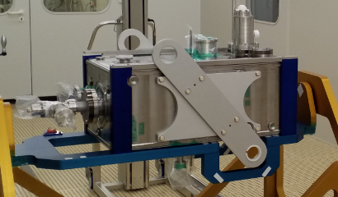
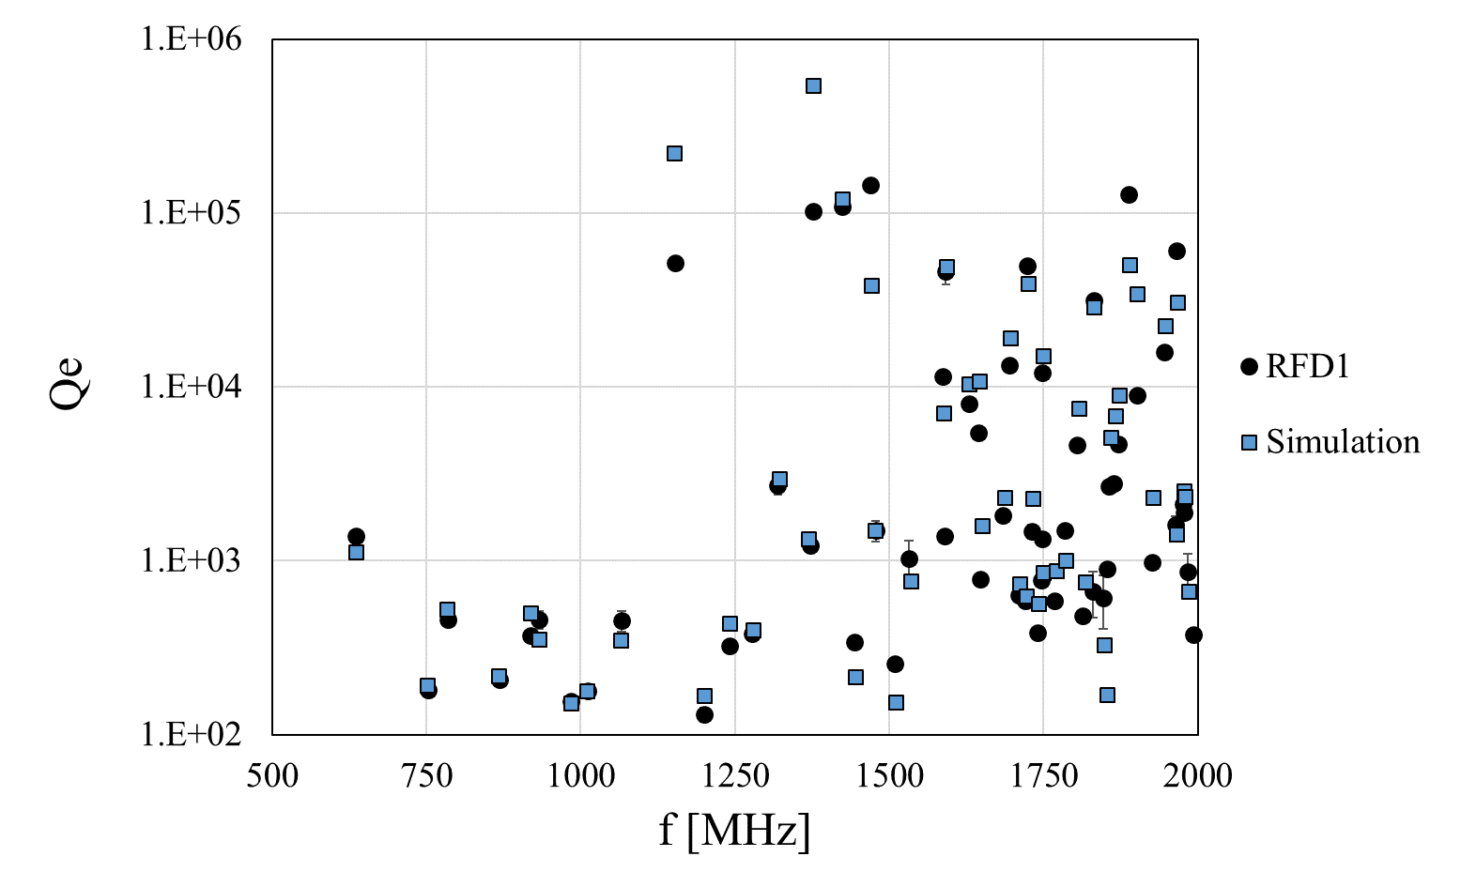
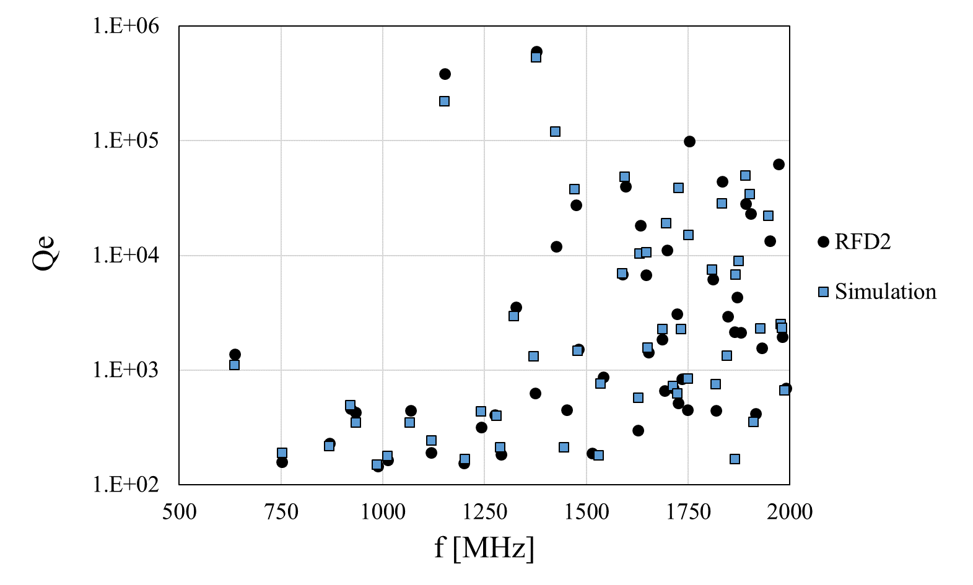
HOM measurements
f Vs Q for both cavities, modes spectra very similar to simulations.
High frequency deviations expected (cavity tuned for f₀).
Acceptance criteria: catalogue mode parameters.

Slide 14
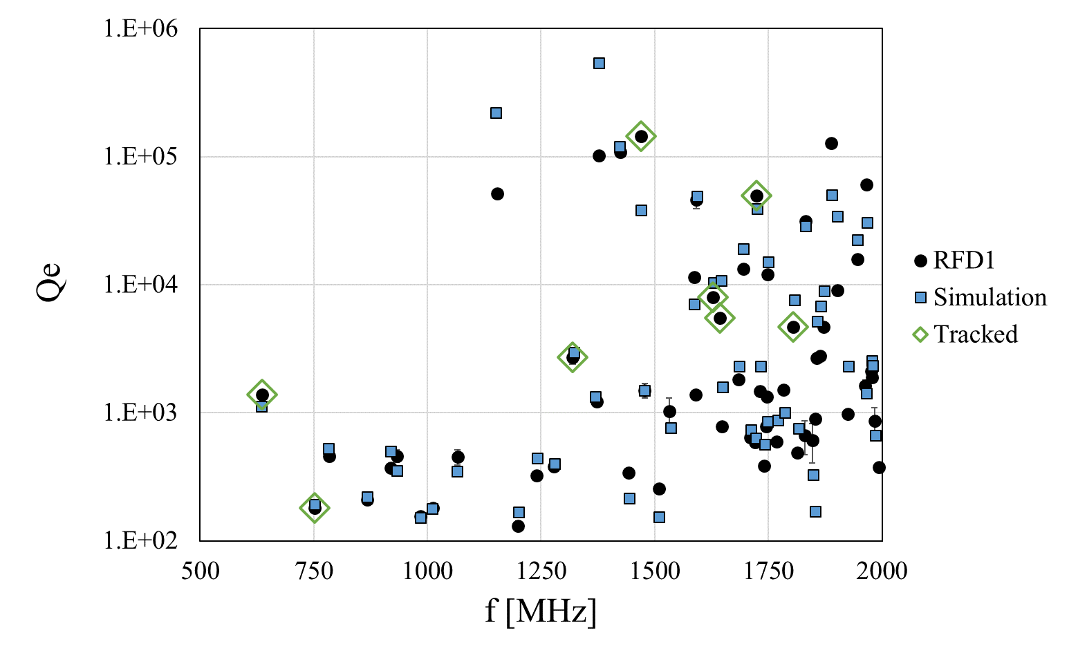
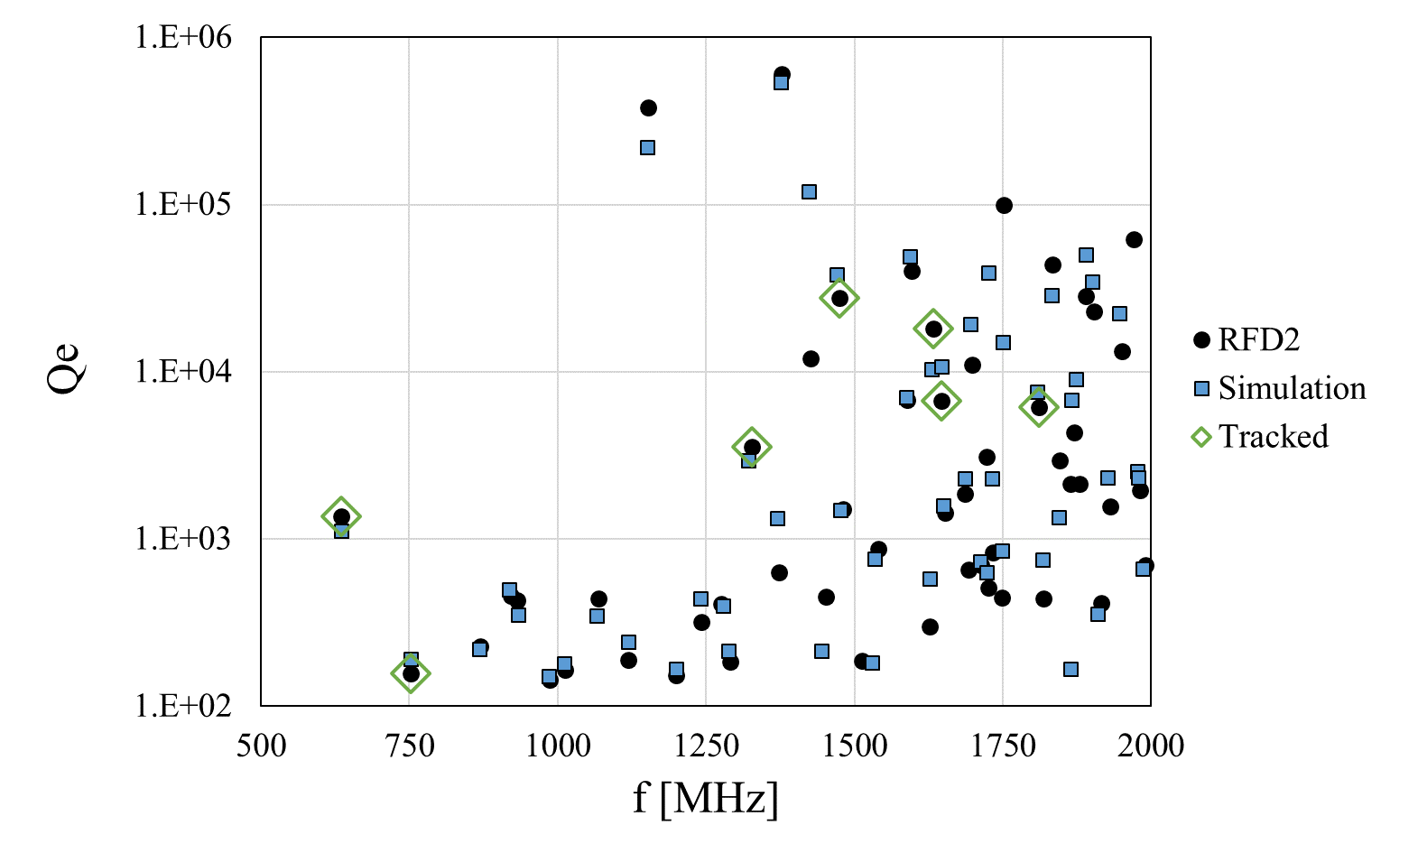
HOM measurements
High impedance modes tracked for cataloguing and analysis.
Acceptance criteria: Simulation / measurement deviations for high Z modes submitted to beam dynamics experts for further analysis.

Slide 15
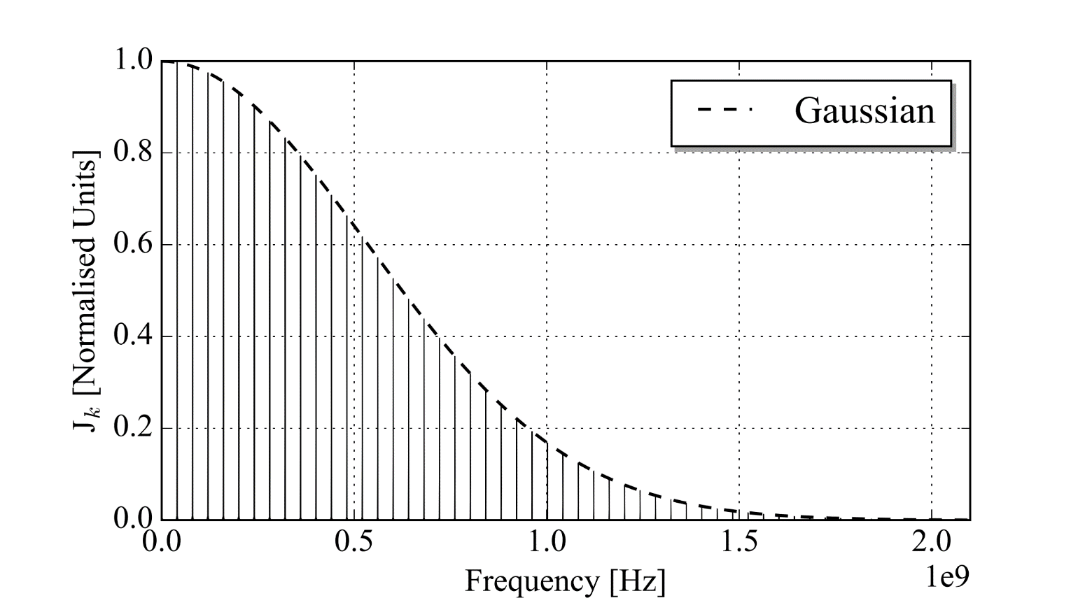
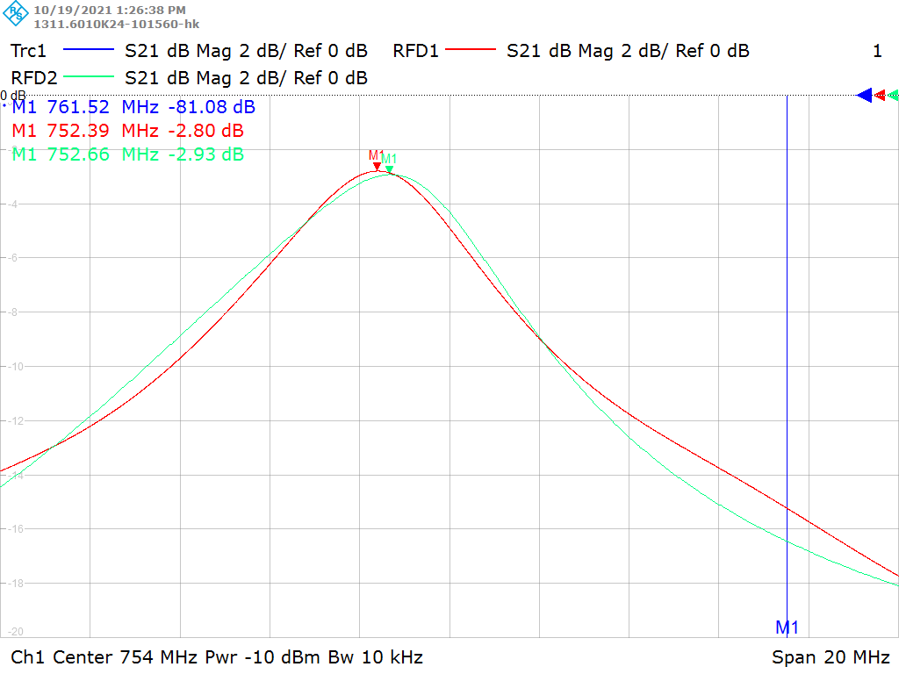
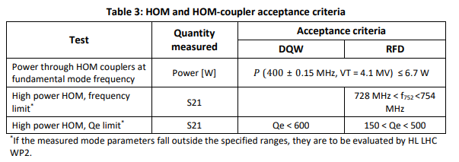
High power HOM
No risk of high heat loads for this mode!
Depending on the mode parameters, interaction between the 750 MHz longitudinal mode and the 19th bunch spacing harmonic of HL-LHC type beam can produce large heat load.
Strict frequency and quality factor limits placed on this mode.
Both cavities within threshold! HOM power << 1 kW and within specification.
Mode frequency and Q-factor reproducible.
[2]
Again, congratulations to SY-RF-AC and EN-MME for both the cavity (mode frequency) and coupler (mode external-Q) manufacture.

Slide 16
Fundamental mode rejection
Fundamental mode leakage limit of < 6.7 W at V_{T} = 4.1 MV
All meet acceptance criteria!
This shows the validity of the HOM coupler test box as a qualification test.
[2]

Slide 17




Conclusions
In collaboration with and thanks to:
Impedance adapters designed and manufactured.
HHOMC test-box qualified couplers and allowed selection criteria
HOM measurements align with simulations
High power HOM within specification
Fundamental mode rejection within specification
Qualified before installation on the test-box.
Used on the cavity and ‘posed no issue’.
Agree below 1.2 GHz, very consistent manufacture.
High frequency qualification on-going.
Important HOMs tracked and measured.
Maximum HOM power < 1 kW with HL-LHC beam
< 10 W @ V_{T} = 5 MV

Slide 18


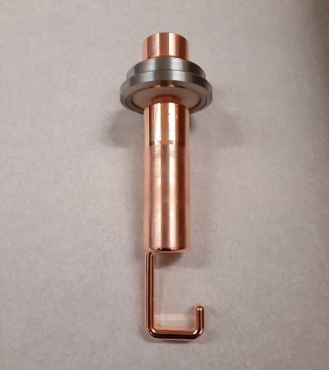

Thanks! Questions …
In collaboration with and thanks to:
Thanks my management for the great opportunities.
Thanks to Rama, Ofelia and the HiLumi project management for such interesting work.
Thanks to Seb, Antoine, Stefanie, our colleagues in SM18 and in EN-MME for the amazing work, collaboration and fruitful discussions.
H-HOMC
V-HOMC
FA

Slide 19
References
[1] Non-conformity report for 10-16 adapter: EDMS 1501109
[2] Crab Cavity HOMs - Details and Qualifications: EDMS 2488213

