Slide 1
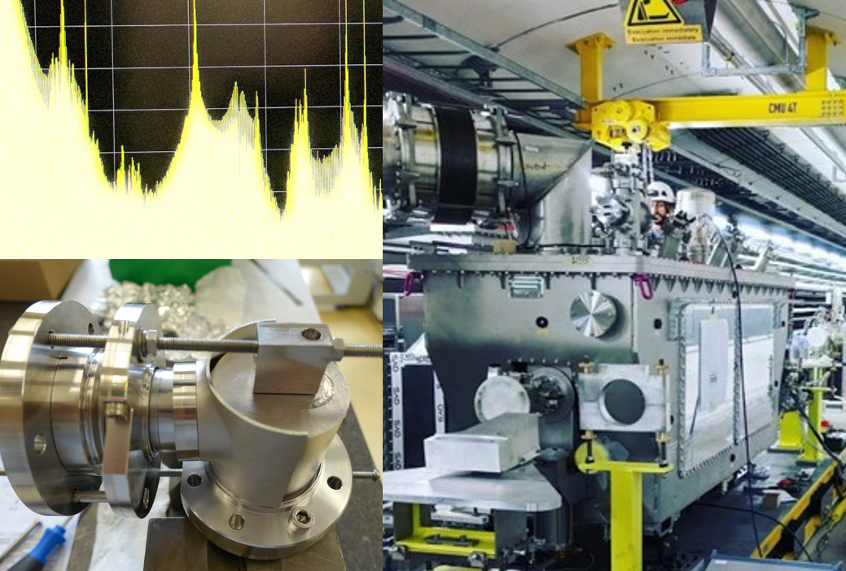
HL-LHC DQW HOM Coupler
Design and SPS Measurements
J. A. Mitchell
Lancaster University and CERN
2nd October 2018, Cornell University
ICFA Mini Workshop on Higher Order Modes in Superconducting Cavities (HOMSC2018)

Slide 2
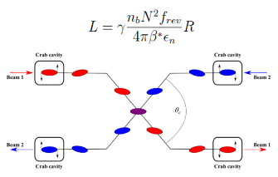
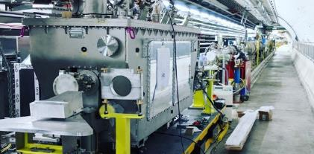
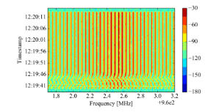
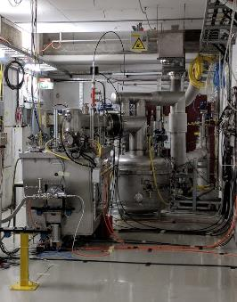
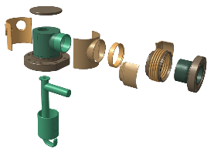

Outline
HiLumi LHC
HOM Ancillaries
SPS Test Stand
Pre-Installation
HOM Coupler Evolution
Beam
Concs.

Slide 3
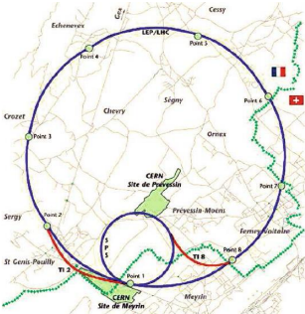
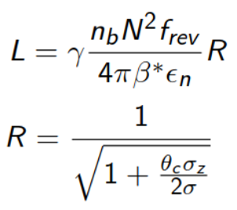

HL-LHC
The Large Hadron Collider (LHC) is the largest particle accelerator in the world at 27 km in circumference.
The HL-LHC will increase the luminosity by reducing the value of $β$*.
Number of particle-particle collisions.
 | LHC | HL-LHC
Peak Luminosity [cm⁻²s^{-1]} | 1 x 10³⁴ | 5 x 10³⁴
Integrated Luminosity [fb⁻¹] | 40 | 250
HL upgrades increase the crossing angle – acts to reduce luminosity!
To reduce the crossing angle: superconducting RF crab cavities.
HiLumi LHC

Slide 4
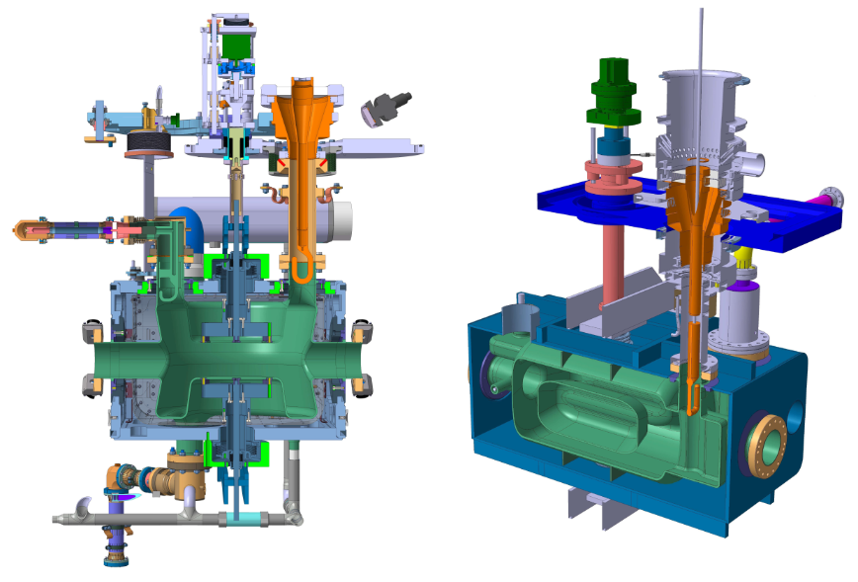
Crab Cavities for HL-LHC
TEM Structures
400 MHz
Dipole mode
No LOMs
Double Quarter Wave (DQW)
Vertical Crabbing
Radio Frequency Dipole
(RFD)
Horizontal Crabbing
HiLumi LHC

Slide 5
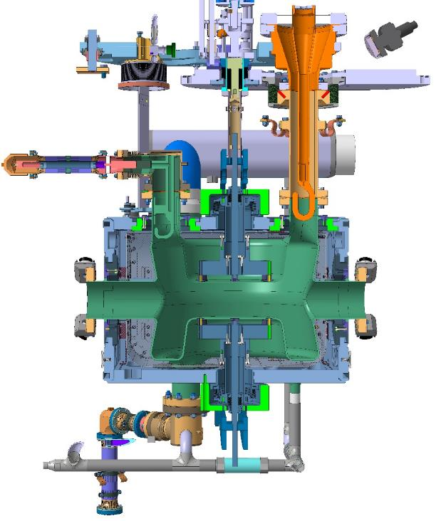
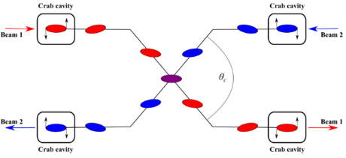
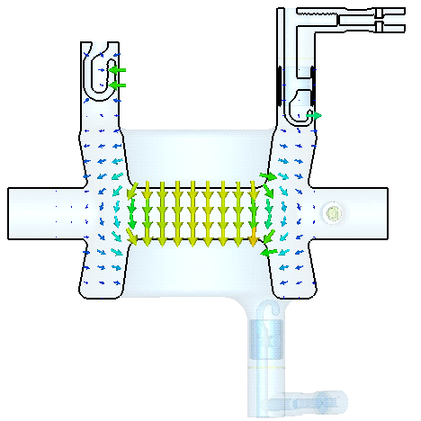
DQW Crab Cavity
Purpose: Rotate proton bunch.
Operation
400 MHz deflecting mode.
Superconducting Niobium (2 K Operation).
Dipole mode.
Field is only E-Field
Kick voltage is actually combination of E and H.
HiLumi LHC

Slide 6
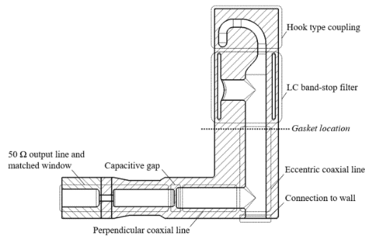
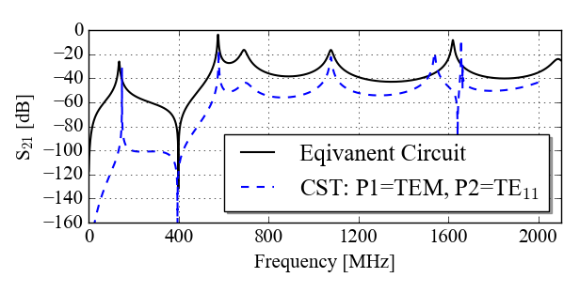
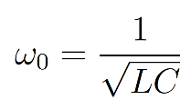
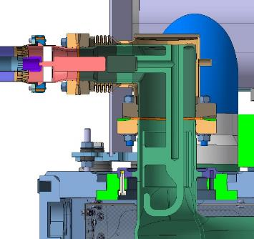
DQW HOM Coupler
Vacuum model
Operation:
Hook-type coupling (electric and magnetic).
  Demountable.
High-pass filter response.
LC band-stop filter.
Capacitively coupled output.
  Broadens notch.
  No moment on window.
Niobium
Conductively cooled by superfluid L-He (2 K)
HOM Ancillaries

Slide 7
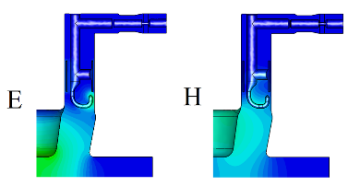

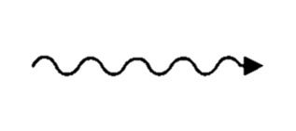
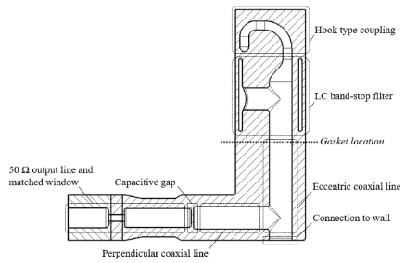
DQW HOMC: Design Advantages
Gasket location
Gasket heating
  The LC band-stop is before the gasket.
  This acts like an electrical short.
  Very little dynamic heat load on the copper gasket (~ mW)!
  CRYOMODULE HAS DYNAMIC HEAT LOAD LIMIT (~ 20 W).
Beam
2. Window location
  Window is perpendicular to charged particles ejected from beam.
  WINDOW BREAKS → CRYOMODULE DOWN!
HOM Ancillaries

Slide 8
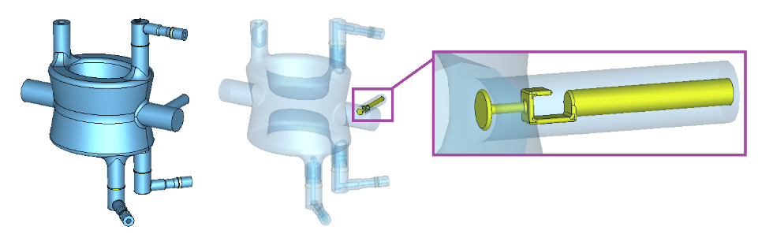
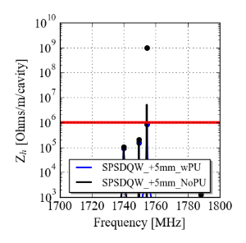
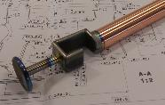
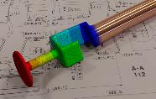
Field Probe as Fourth HOM coupler
The pick-up is designed extract 1 W at the fundamental mode frequency → Q_{e} = 1.6 x 10¹⁰.
It is also a HOM coupler for the 1.75 GHz mode → cannot couple to this mode with HOM couplers.
The PU is made from Nb and Cu to avoid heating.
HOM Ancillaries

Slide 9
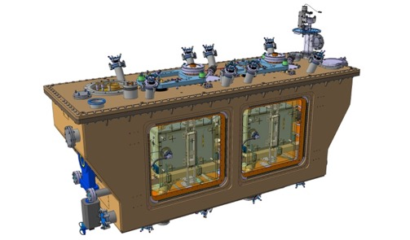
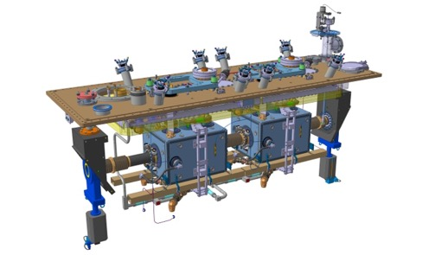
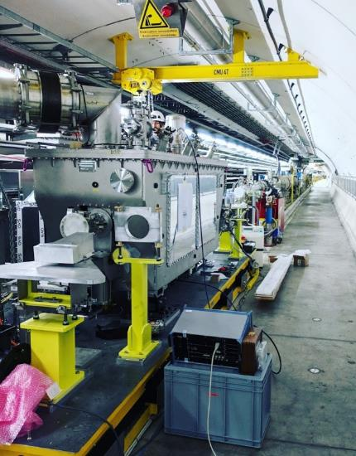
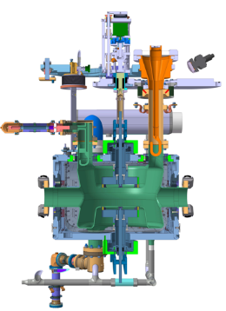
SPS Crab Test Stand
Field probe
Tuner
HOM Couplers (x3)
FPC
DQW crab cavity (vertical)
Helium Vessel
Cold magnetic shielding
SPS Test Stand

Slide 10
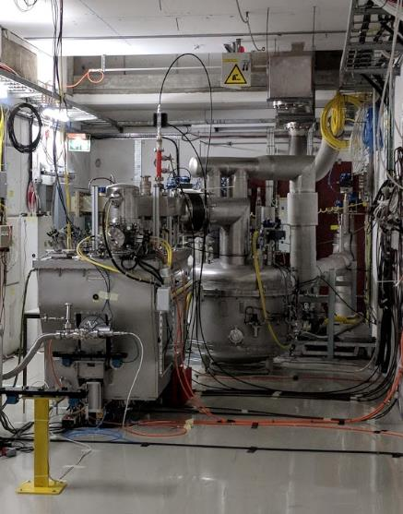
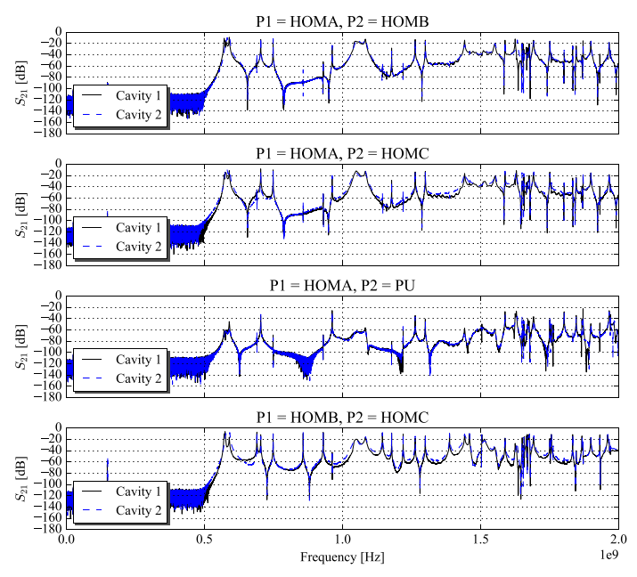
Mode Measurements
Transmission measurements using VNA in cryomodule cold test in M7 bunker.
Pre-Installation

Slide 11
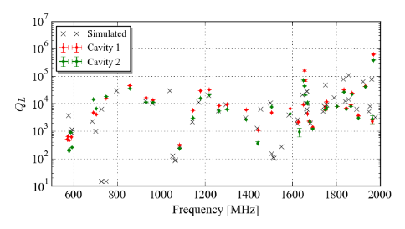
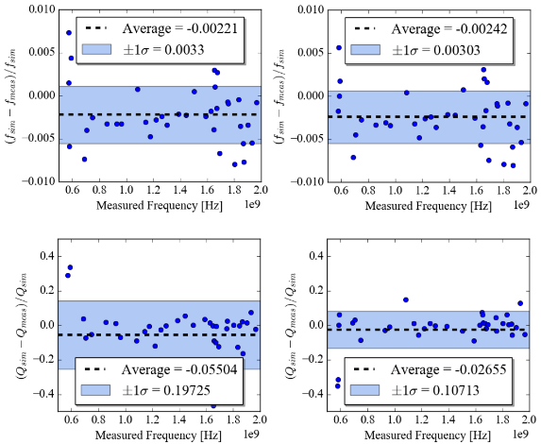
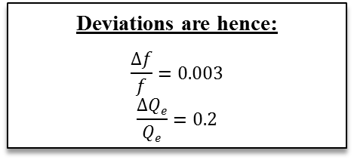
Mode Measurements
Transmission measurements using VNA in cryomodule cold test in M7 bunker.
Deviations are hence:
$$\frac{Δf}{f}=0.003$$
$$\frac{ΔQe}{Qe}=0.2$$
Pre-Installation

Slide 12
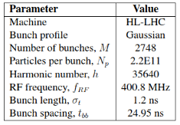
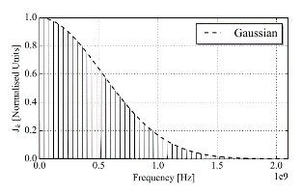
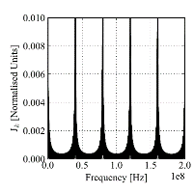
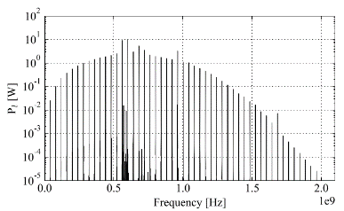

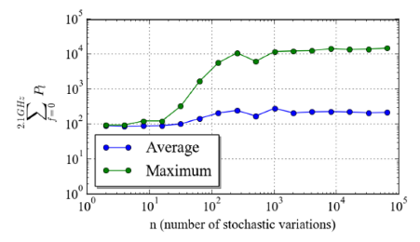
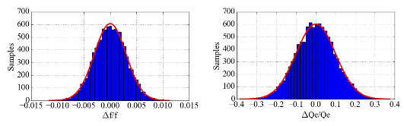

HOM Power
Using SPS HOM coupler and HL-LHC parameters:
$$ΣP<100 W$$
However, the frequency and Q_{e} of the modes can change.
Stochastically varying these two parameters, a worst-case power can be calculated.
13 times larger than 1 kW limit.
Due to mode at 960 MHz – coupler needs to be altered.
HOM Coupler Evolution

Slide 13
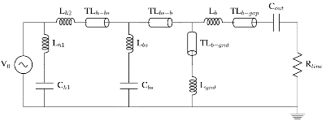
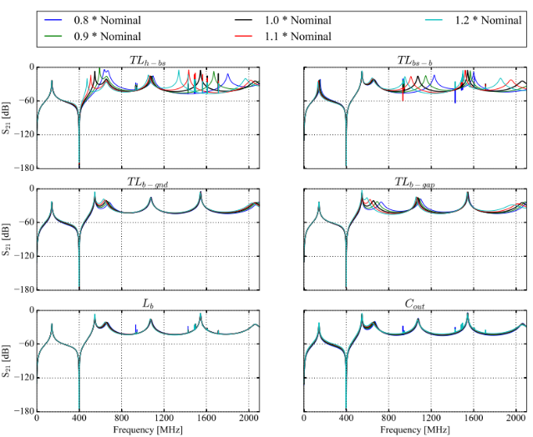
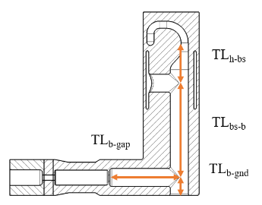
SPS HOM Coupler Development
The coupler should be altered to:
  Reduce transverse impedance below threshold.
  Reduce maximum foreseeable HOM power to below 1 kW.
  Improve ease of manufacture.
HOM Coupler Evolution

Slide 14
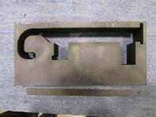
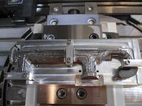
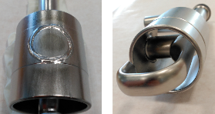
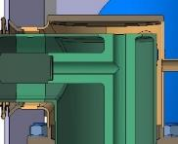
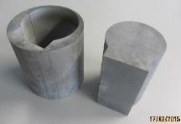
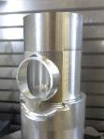
SPS HOM Coupler Development
The coupler should be altered to:
  Reduce transverse impedance below threshold.
  Reduce maximum foreseeable HOM power to below 1 kW.
  Improve ease of manufacture.
Issue
Solution
Machining time for circular cross-section.
Rectangular cross-section.
Difficult to EB-Weld on curved surface.
Flat section on capacitive jacket.
Wasted Material:
Perpendicular coax line is ‘flush’ with coupler base.
Lift output line.
HOM Coupler Evolution

Slide 15
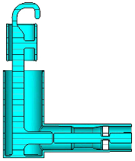
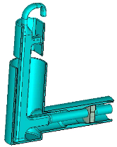







DQW HOMC V2
Flat section on capacitive jacket.
Square profile throughout.
Lifted output line for extruded ‘can’.
Highest power still a result of the 960 MHz mode.
If we vary this mode in frequency:
HOM Coupler Evolution

Slide 16

Modified Impedance Spectra
Impedance spectra:
  Frequencies and Q_{e} values are known for a large number of modes.
  Simulated spectra altered for both cavities.
  Note, remembering to use the +5 mm simulation results!
For both cavities the 960 MHz mode has increased in frequency.
From BELOW to ABOVE the harmonic!
This shows it is feasible for the mode to be excited by the 24th harmonic at 25 ns bunch spacing.
Beam

Slide 17


Measurements with Beam
Measurement aims:
  Validate we can predict HOM power accurately.
  Validate we have not ‘missed modes’ in simulation.
  Validate power increases with intensity (and bunch number) as expected.
A binomial distribution was initially used to represent the bunch profile.
H1
H2
H3
Beam

Slide 18


Meas. with Beam: Single Bunch
27/08/2018: MD4
Cavity 1 - HOMC1
Cavity 2 - HOMC1
Analytic underestimates
Unforeseen power at 1.8 GHz
Beam

Slide 19



Meas. with Beam: Single Bunch
27/08/2018: MD4
Mode [MHz]
Top HOM Coupler
Bottom HOM Coupler
580
704
960
1263
High resolution narrow band scans also taken on high Z_{l} modes.
Analytic under-represents power in all cases.
Large coupling difference seen between modes.
Beam

Slide 20


Meas. with Beam: Measured Profile
05/09/2018: MD5
To evaluate whether the beam profile was the cause of the underestimation.
In the following crab cavity test (MD5) the bunch profile was measured during the coasts.
This time multiple bunches were used with a bunch spacing of ~ 525 ns.
Courtesy of M. Schwarz
Conclusion: If HOM is near to binomial ‘node’: Optimistic and sensitive to bunch length.
Beam

Slide 21




Meas. with Beam: Measured Bunch Profile
05/09/2018: MD5
Predicted is total power, not accounting for intra-coupler power flux.
There are still discrepancies between the measured and analytical.
This is under investigation:
  Cable transfer function, mechanical position of HOM couplers, calibrations, bellows etc…
Beam

Slide 22




Meas. with Beam: Power Distribution
H1
H2
H3
Measured power ratio for 4 high longitudinal impedance modes.
Cavity 1
Cavity 2
Beam

Slide 23



Meas. with Beam: Multibunch
27/08/2018: MD3
Cavity 1
590 MHz
700 MHz
960 MHz
590 MHz mode is underestimated by > 10 dB.
Using measured profile could account for 5 dB.
Q or R/Q is underestimated.
Beam

Slide 24


First HOMs
590 MHz mode is higher in power than predicted by > 10 dB
Decrease in damping:
  Transmission measurements on cavity show the difference between cavities.
  Test box measurements show a large deviation in the coupler’s ‘transfer function’.
  Tolerance on LHC couplers should be larger.
Cavity
Test Boxes
Beam
Notes:
X-scale
Differences in coupling – under investigation

Slide 25
Conclusions
Coupler re-design constraints from:
  Manufacturing experience for SPS test.
  Measurements on SPS test stand.
HOM coupler altered to reduce power and improve ease of manufacture.
HOM Power compared with single-bunch and multi-bunch.
  Under-represented by analytic bunch profile.
4. Notable Observations:
  960 MHz is dominant mode for power and > 95 % through top HOM coupler.
  590 MHz mode is 10 dB higher than expected.
  High frequency power not expected – being investigated.
SPS test has been great learning experience for HOM related topics.

Slide 26
Thanks for your attention

Slide 27
Back-Up Slides

Slide 28

Re-design
Assembly constraints…
Presented at HiLumi’17
HOM Coupler Evolution

Slide 29


DQW HOMC: Eqiv. Circuit
Equivalent circuit modelling can reproduce the transmission response of the coupler very well.
The circuit simulations are many order of magnitudes faster than the 3D FEA simulations.
3D electromagnetic simulation
CST MWS
Equivalent circuit response
AWR
HOM Ancillaries

Slide 30




Non-conformity
All HOM coupler ports are + 5 mm compared to design.
Reduces coupling to majority of HOMs
Does not present impedance issue for SPS test.
SPS Test Stand

Slide 31


RF-Mech: Thermal
Magnetic field on coupler → Ohmic losses → Heating
The heating is a function of:
  Amplitude of the magnetic field.
  Heat transfer coefficient.
Coupler is internally cooled by 2 K SUPERFLUID Helium.
  Frictionless flow of liquid through channel.
  Heat energy deposited in helium bath.
  Note(!): 1 W/cm² limit.
Visualisation of Surface current [A/m] on HOM coupler.
Both of these are a function of to material properties and temperature.
Hook is the most at risk from heating!
  Highest H-field
  Large distance from cooling channel.

Slide 32



RF-Mech: Thermal
Electrical Conductivity
Thermal Conductivity
Varies with literature.
Phonon peak varies dramatically with chemical processing [T1].
I use a pessimistic approach (orange curve).
‘Phonon peak’
[T1] P. Dhakal, Superconducting DC and RF properties of Ingot Niobium. Thomas Jefferson National Accelerator Facility, CA 23606, US.

Slide 33






RF-Mech: Thermal
Iterative Simulation Technique:
Simulate electromagnetic fields in cavity structure for given temperature and residual resistance (CST) and scale to V_{T} = 3.4 MV.
Simulate heating using thermal conductivity at that temperature.
Iterate until temperature convergence.
  Note: We split into sections and pessimistically take the maximum temperature.

Slide 34

RF-Mech: Multipacting
Resonant electron instability
Electron strikes surface (with certain energy).
Generates (on-average) more than one secondary particle.
If secondary returns with same RF phase and energy – avalanche effect – exponential electron growth.
The electrons are a well for RF power – limiting the cavity from increasing in voltage.
G. Burt (Lancaster University)

Slide 35




RF-Mech: Multipacting (…double point)
Average secondary electron yield
Highlights voltages at which multipacting could occur.
No. of particles Vs time
Shows avalanche effect over time.
Impact energy at different field levels
Highlights incident energies with field level.
Note, the results are for a modified coupler, but present multipacting sims. conceptually.

Slide 36


Evolution - Feedthroughs
Content from E. Montesinos (CERN)
HOMC power lines
Rated to:
16 kW pulsed 1ms – 1Hz
4 kW CW during 8 hours
Vertical test – feedthroughs leaked!
… in parallel

Slide 37

Evolution - Feedthroughs
Content from E. Montesinos (CERN)
Now only 200 W capability
Fine for SPS test
Need to be modified for HL-LHC

Slide 38





DQW HOMC: Alternative
$$\frac{λ}{4}$$
$$(c/f)/4=(3E8/400E6)/4=188 mm$$
Quarter wave rejection filter – centered at fundamental mode.
Harmonics reject also.
Advantages
Loop type coupling – magnetic coupling to HOMs – good broad-band damping.
High H-Field on cooled section – no $Δ$T to He.
Very easy to manufacture - mass produce.
Disadvantages
Gasket heat-load – 1000 x higher than LC stopband.
Harmonics can be moved slightly but will always be present.
$$Gasket H−shield$$

Slide 39




Future Ideas – HOMC Conditioning
FPC’s are conditioned before installation:
Acceptance test, desorption of absorbed gasses, ensuring required power level (without RF breakdown), training ceramic…
Technique
Power, pulse length, duty cycle: Low → High (with FM and AM)
Using ‘test-box’ in travelling wave mode.
HOM couplers are becoming higher and higher in power
Do not see high power at high frequency until beam!

Slide 40



RF-Mech: Test Boxes

