Slide 2
HOM couplers for crab cavities and challenges
James Mitchell
CERN, BE-RF-PM
BE-RF-PM
TTC 2020
james.mitchell@cern.ch

Slide 3
Crab cavity damping
Damping requirements:
$$Z_{∥}<200 kΩ$$
$$Z_{⊥(x,y)}<1 MΩ/m$$
1 x HF Damper
1 x Field Antenna
3 x HOM Coupler
1 x H-HOMC
1 x V-HOMC
1 x Field Antenna
Double Quarter Wave (DQW)
Radio Frequency Dipole (RFD)
BE-RF-PM
TTC 2020
james.mitchell@cern.ch

Slide 4
Crab cavity damping
Dressed cavities tested without beam.
Dressed DQW tested with beam!
S. Verdu-Andres
BE-RF-PM
TTC 2020
james.mitchell@cern.ch

Slide 5
Topics
Dynamic heat loads (gasket heating)
Change of characteristic impedance (Z₀)
BE-RF-PM
TTC 2020
james.mitchell@cern.ch

Slide 6
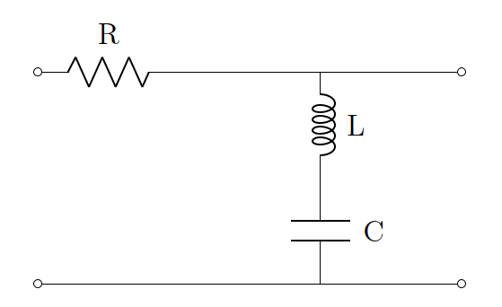
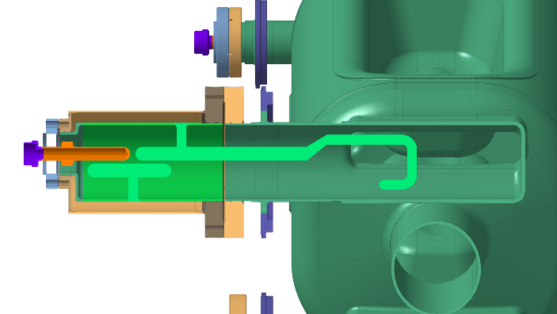
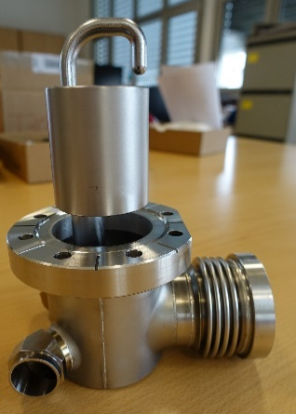
Dynamic Heat Loads
Dynamic heat load on gaskets reduced by:
ω_{c} $=\frac{1}{\sqrt{LC}}$
a
$$\frac{c}{2f_{HOM1}}<a<\frac{c}{2f_{0}}$$
Rejection filter before the gasket.
→ complicated geometry
→ high fields on hook
broad notch (mW level heat-load)
Waveguide with f_{c} > 400 MHz
→ hard to machine and weld
→ higher nominal gasket heat-load
→ less sensitive to tolerances
Could complex couplers and cavity shapes could be avoided with SC seals?
BE-RF-PM
TTC 2020
james.mitchell@cern.ch

Slide 7
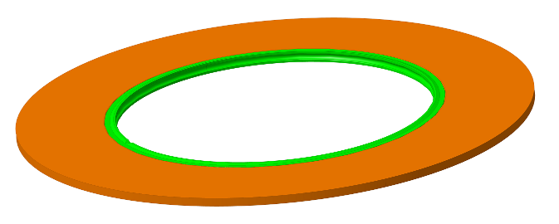
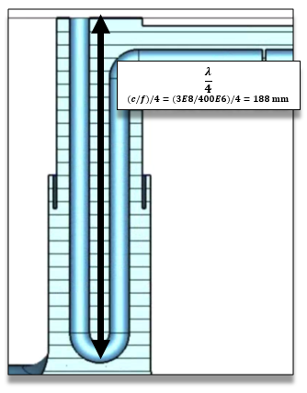
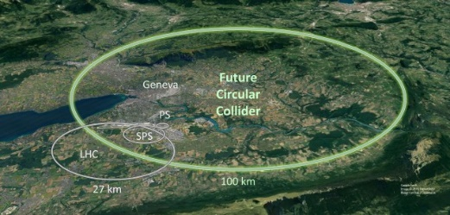
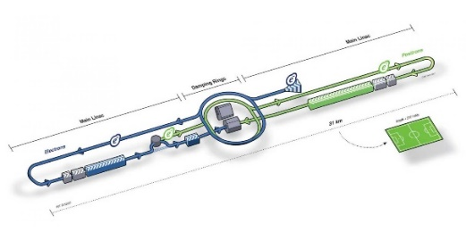
Dynamic Heat Loads
Dynamic heat load on gaskets could be reduced by: Superconducting seals*.
Resulting in more ‘manufacturable’ cavities and couplers.
Material | Rs @ 2 K [Ohms]
Copper | ~ 1 e-3
Niobium | ~ 20 e-9
We are trialing several options for tests!
Future high energy machines → mass production.
Do superconducting seals allow simplification of cavity and coupler geometries?
On DQW the copper gasket heat-load is 2-20 W
*Existing literature on the use of superconducting seals in back-up slides.
BE-RF-PM
TTC 2020
james.mitchell@cern.ch

Slide 8
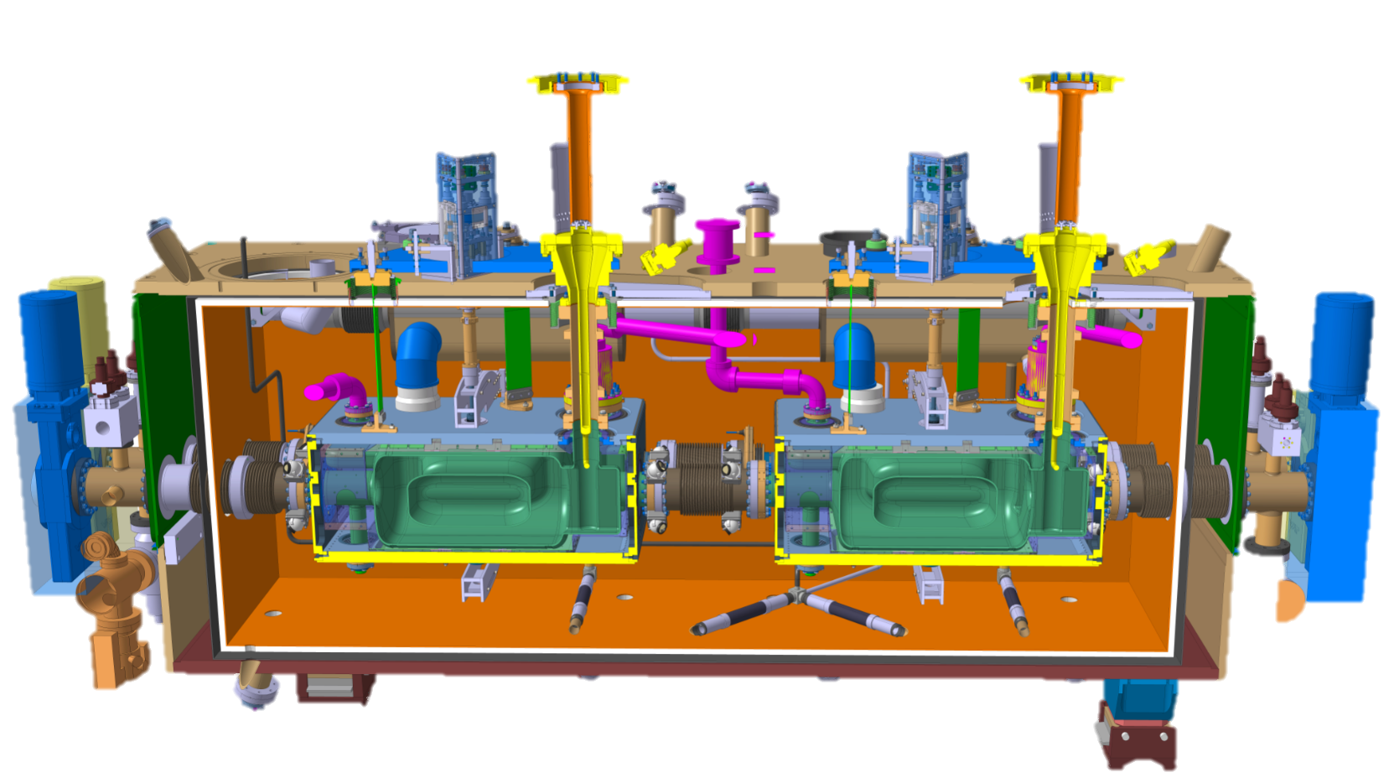
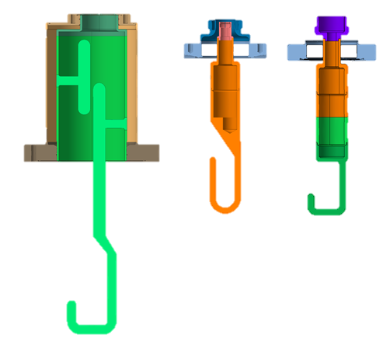
Changing Z₀: Manufacture and Transport
BE-RF-PM
TTC 2020
james.mitchell@cern.ch

Slide 9
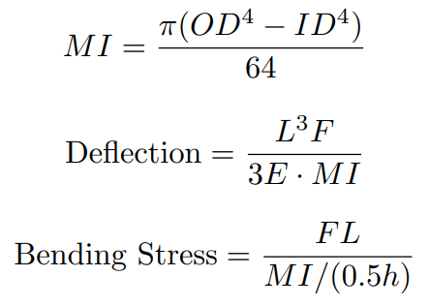
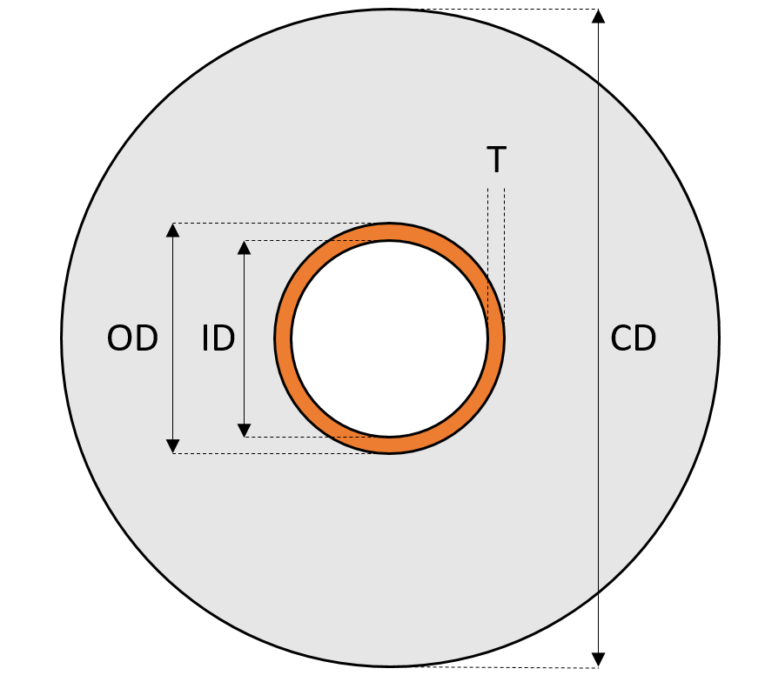
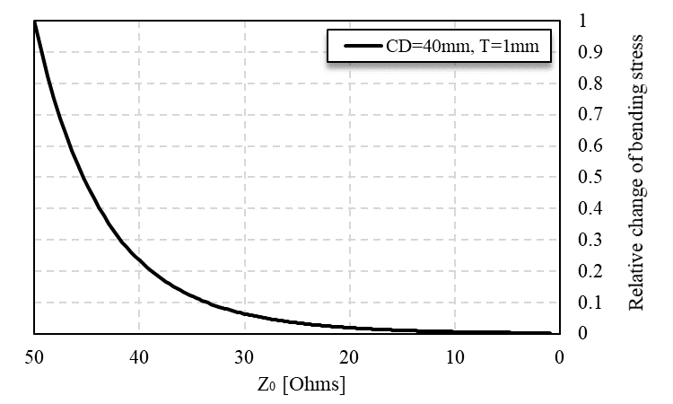
Changing Z₀: 50 Ω → 25 Ω
… concerns over thin diameter in feedthrough.
Changed to Z0 = 25 Ω.
M
Transported in horizontally position.
Large moment on thin inner conductor!
*
Since $Z∝log\left(OD/ID\right)$, diameter increases by factor of 3.7 if we move to 25 Ω.
Bending stress reduces by at least factor of 30.
Z0 [Ω] | ID [mm]
75 | 0.78
50 | 2.90
25 | 10.77
*
Shock test results and videos in back-up slides!
* Approximation without taking into account the boundary conditions of the ceramic.
BE-RF-PM
TTC 2020
james.mitchell@cern.ch

Slide 10
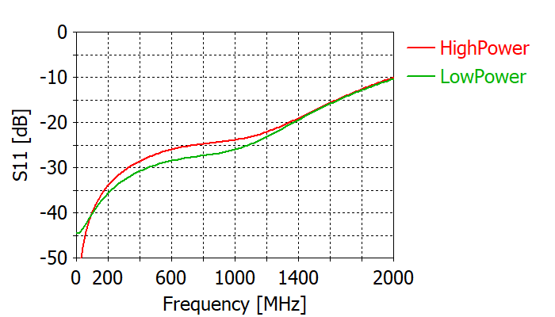
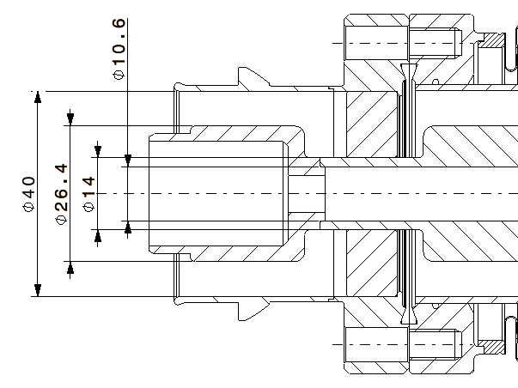
Changing Z₀: 50 Ω → 25 Ω
With the steps and clearances needed for manufacture.
Inner diameter of 14 mm gave best broadband matching!
Chose 25 Ω, because 25 Ω = 50 Ω || 50 Ω
Feedthroughs designed.
There is now a common 25 Ω feedthough validated with thermal shock and ‘drop test’.
BE-RF-PM
TTC 2020
james.mitchell@cern.ch

Slide 11
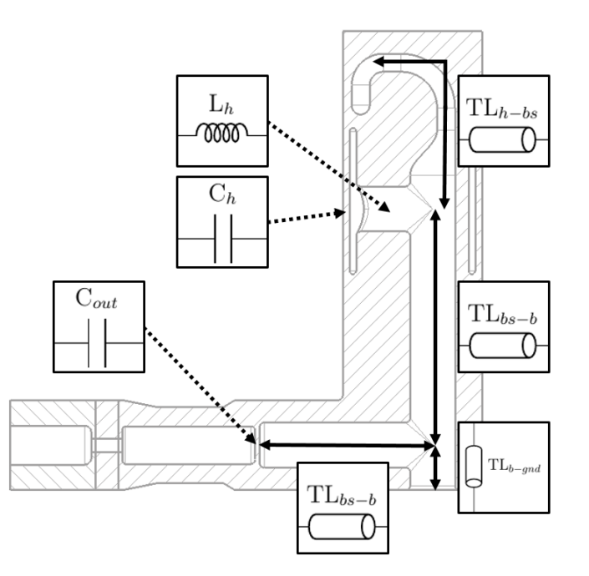
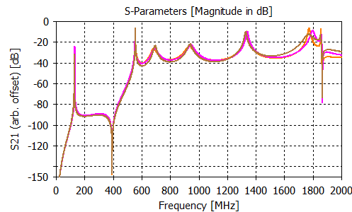
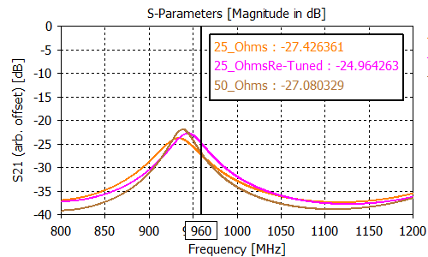
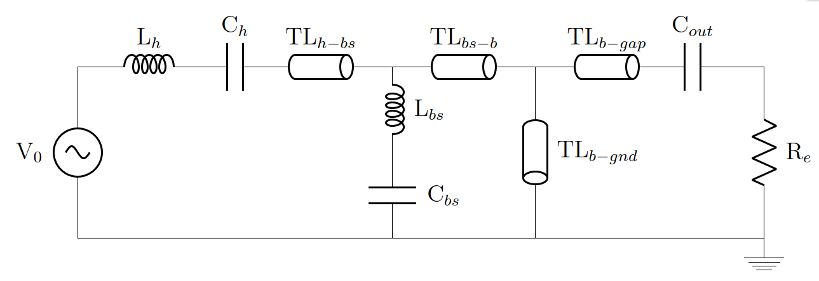
Changing Z₀: 50 Ω → 25 Ω
DQW HOM coupler
Decrease in transmission at high power mode frequency (960 MHz).
Re-tuned - now impedance for this mode is the lowest it has been!
Design thresholds are met with 25 Ohm matching for both cavities!
Cavity impedances in back-up slides.
BE-RF-PM
TTC 2020
james.mitchell@cern.ch

Slide 12
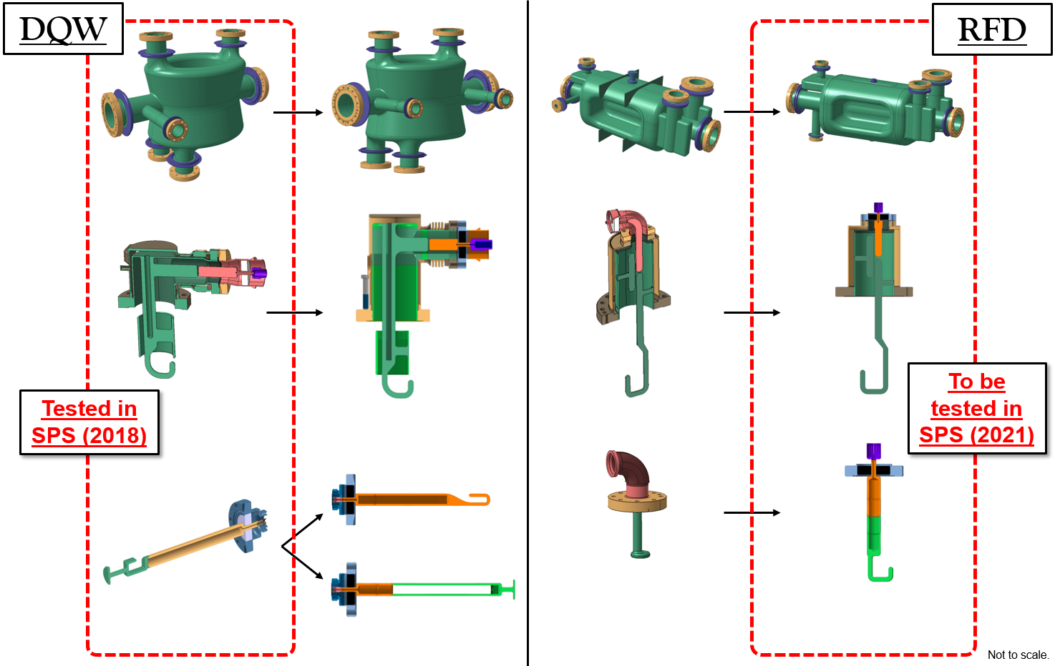
Changing Z₀: 50 Ω → 25 Ω
BE-RF-PM
TTC 2020
james.mitchell@cern.ch

Slide 13
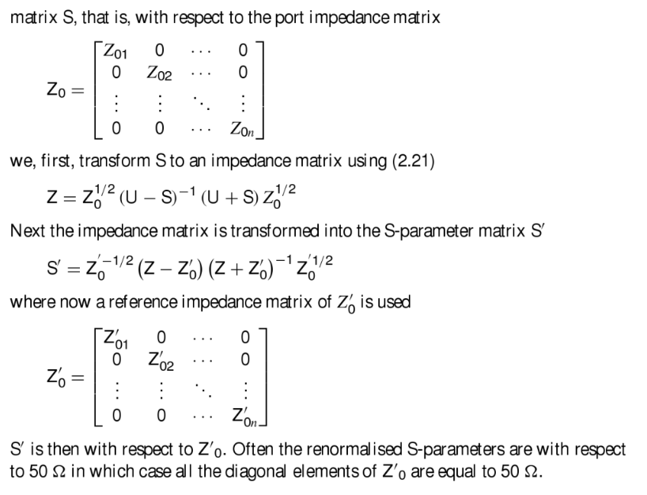
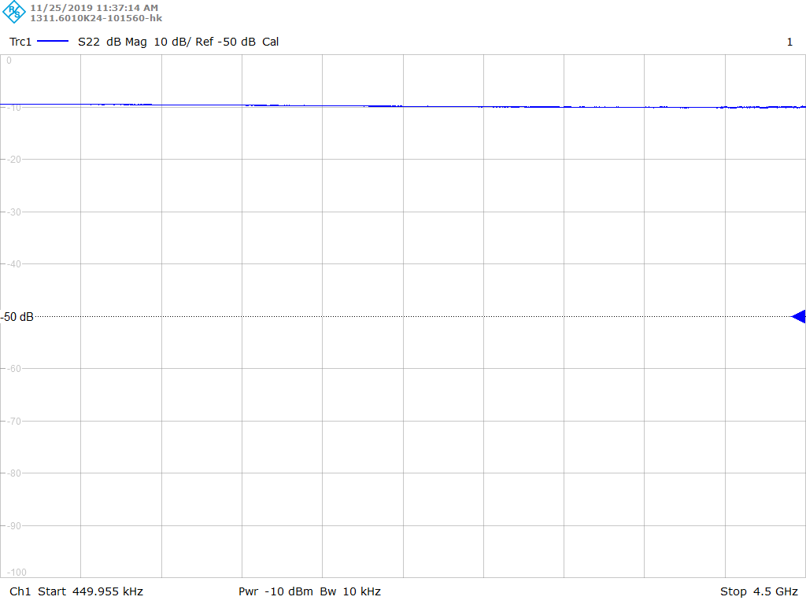
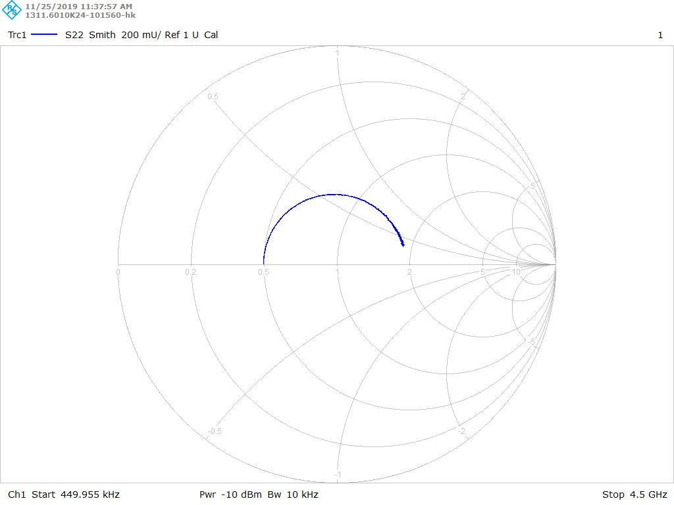
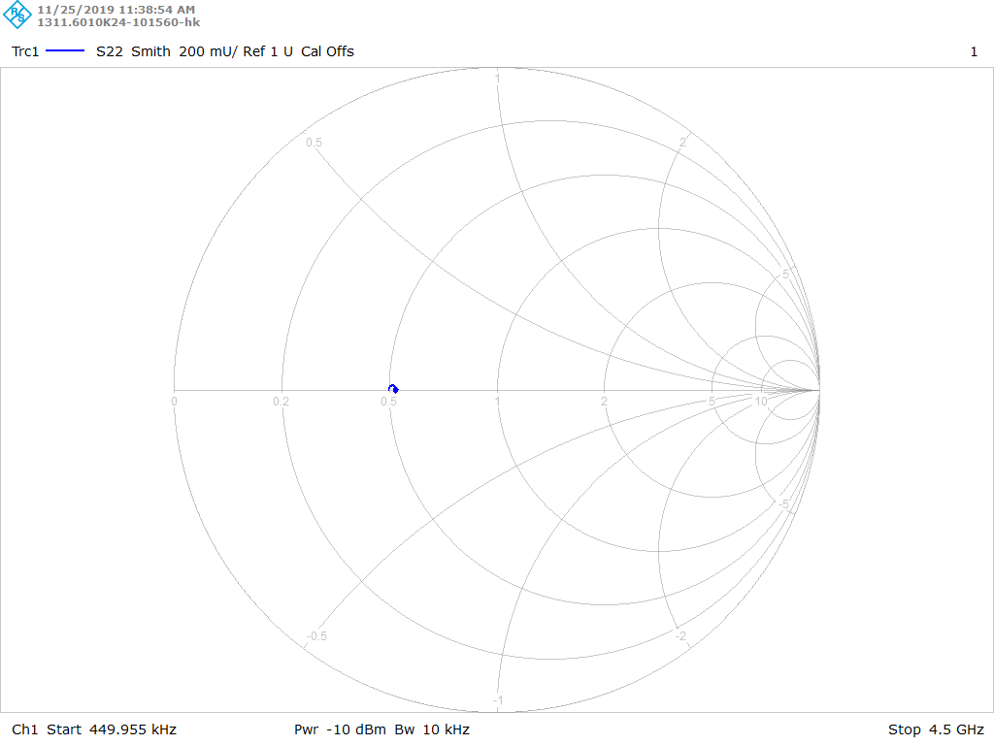
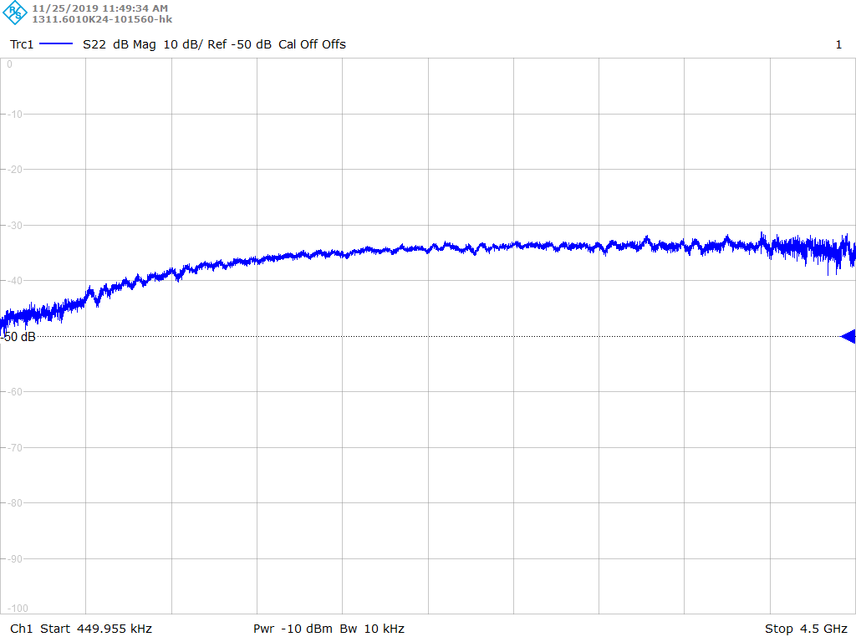
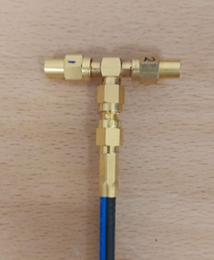
Changing Z₀: 50 Ω → 25 Ω
Infrastructure and measurement challenges.
25 ohm cables and loads are not standard: Make cables of match in parallel?
Using a 50 Ω VNA: port re-normalization, de-embedding, 50 Ω →25 Ω adapters.
WARNING:
Must de-embed adapter to 25 ohm section!
Port renormalization built into new VNAs!
BE-RF-PM
TTC 2020
james.mitchell@cern.ch

Slide 14
Conclusions and Discussion points
Dynamic heat loads
We have reduced H-field.
Could reduce Rs.
Could this lead to simpler structures?
Is there a want for this in the accelerator community?
R&D on-going!
Baseline for crab cavities
Z0 = 25 Ω
Inner conductor is too thin for transport.
25 Ohm infrastructure designed.
Impedance thresholds met.
Challenges: infrastructure and measurements.
BE-RF-PM
TTC 2020
james.mitchell@cern.ch

Slide 15
Thank you for listening!
Thanks to BE-RF-PM and HL-LHC WP4 for the contribution and support.
BE-RF-PM
TTC 2020
james.mitchell@cern.ch

Slide 16
Back-up slides
BE-RF-PM
TTC 2020
james.mitchell@cern.ch

Slide 17
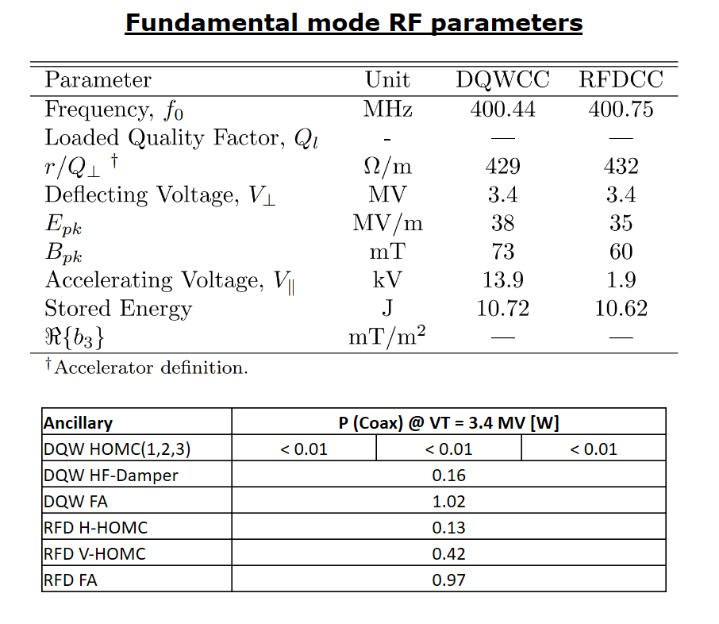
BE-RF-PM
TTC 2020
james.mitchell@cern.ch

Slide 18
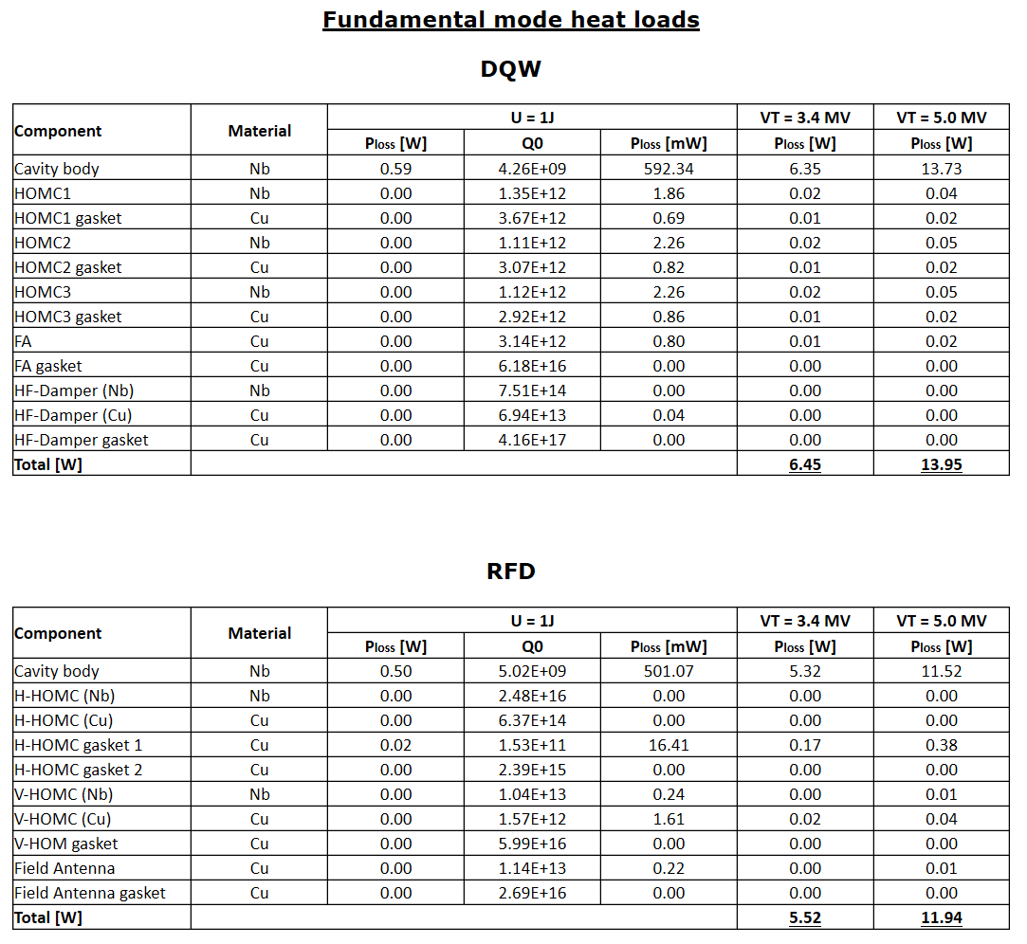
BE-RF-PM
TTC 2020
james.mitchell@cern.ch

Slide 19
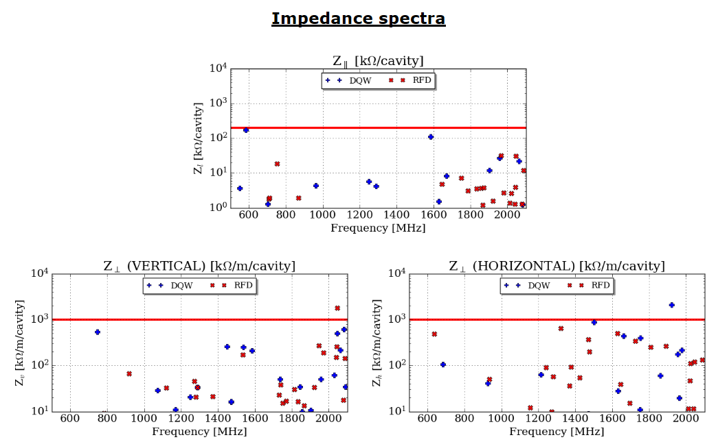
BE-RF-PM
TTC 2020
james.mitchell@cern.ch

Slide 20
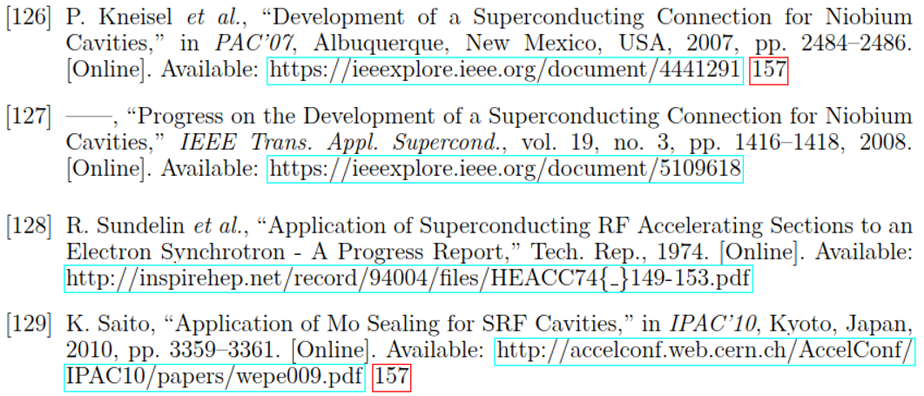
BE-RF-PM
TTC 2020
james.mitchell@cern.ch

Slide 21
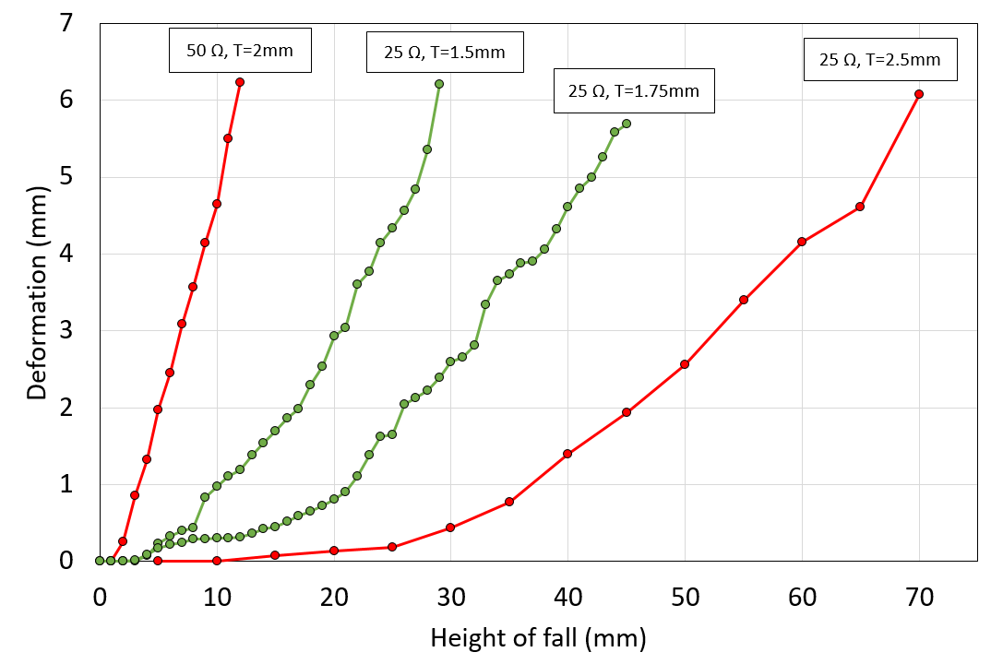
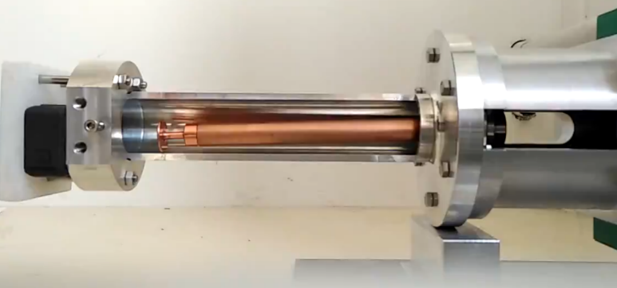
Changing Z₀: 50 Ω → 25 Ω
‘Shock tests’ on-going.
Brazing issue:
Wall thickness limitation.
25 ohm feedthrough was shown to be more resistant to a shock!
BE-RF-PM
TTC 2020
james.mitchell@cern.ch

Slide 22
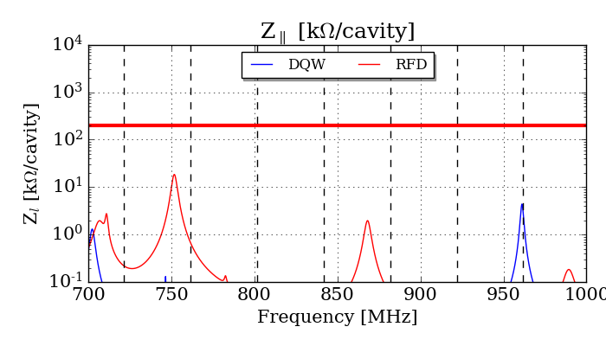
High Power HOMs
Coaxial line power is becoming comparable to FPC power.
Infrastructure for HOM couplers is becoming larger and more difficult to assemble/replace.
What will be the best damping method for future machines?
Using HL-LHC beam parameters:
 | P_{worst-case} (P_{average}) [kW]
 | Gaussian bunch | Binomial bunch
DQW | 1.0 (0.2) | 0.5 (0.1)
RFD | 7.4 (0.8) | 5.9 (0.7)
HOM power from 10,000 stochastic simulations.
Parameters: bunch length, bunch form coefficient, mode frequencies and mode Q-factors.
RFD
DQW
Worst case power at these frequencies.
BE-RF-PM
TTC 2020
james.mitchell@cern.ch
Notes:
LCLS II: FPC → 6 kW

Slide 23
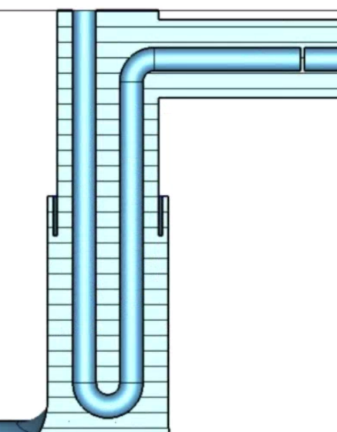
ImageGen
T
$$\frac{λ}{4}$$
$$(c/f)/4=(3E8/400E6)/4=188 mm$$
OD
ID
CD
BE-RF-PM
TTC 2020
james.mitchell@cern.ch

